Slide 1

Votes for Women UK
RFK HUMAN RIGHTS UK
Human Rights through the lens of Women’s Suffrage
Speak Truth To Power

Slide 2
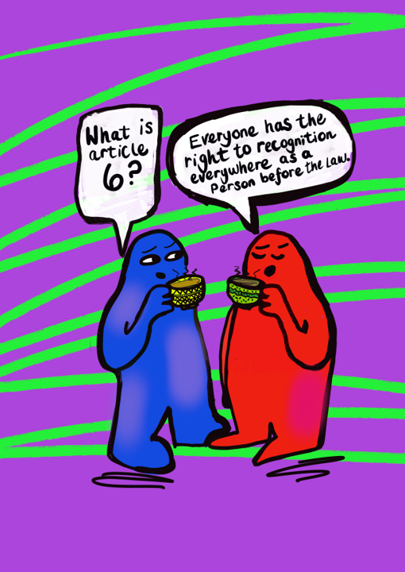


SESSION A:
Article 6; Everyone everywhere has the right to recognition as a person before the law
Artwork by Emma Evans

Slide 3
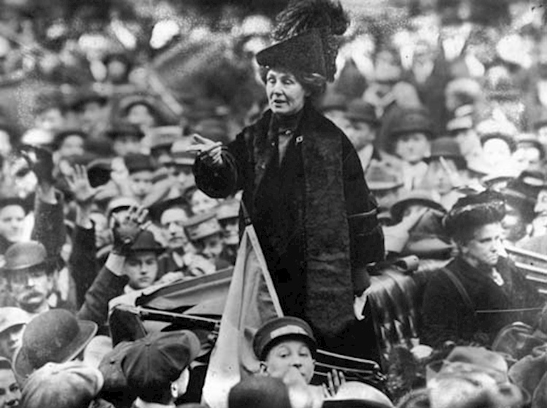
Notes:
https://www.thehistorypress.co.uk/articles/the-pankhursts-politics-protest-and-passion/
Emmeline Pankhurst addressing a crowd in New York in 1913

Slide 4
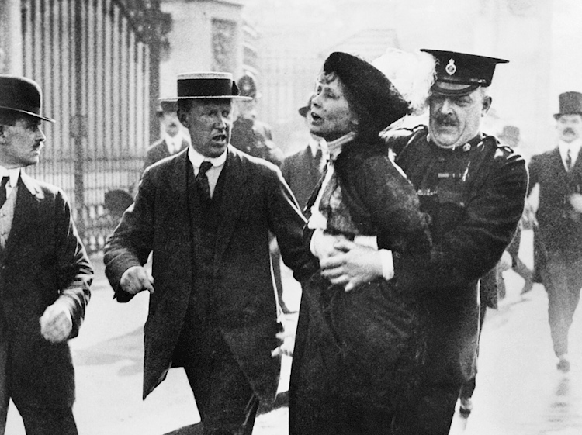
Notes:
https://www.thehistorypress.co.uk/articles/the-pankhursts-politics-protest-and-passion/
Emmeline Pankhurst arrested after protesting near Buckingham Palace in London 22 May 1914

Slide 5
Words You Need to Know
Suffrage – means the right to vote, especially in a political election
Suffragists – originally meant a person advocating that the right to vote be extended to more people, especially to women
Suffragette – was initially used as a sexist insult and was first used a British Dail Mail male reporter in 1906 to belittle the suffragists. It was to imply they were silly, or something to be ridiculed or have more sense.
In the UK, the women's movement co-opted the phrase suffragette although in other areas in the world it is still seen as an insult. UK parliament describe the terms the following way:
Before 1918 no women were allowed to vote in parliamentary elections. In the early 20th century there were two main groups active in the campaign for women's suffrage, a term used to describe the right to vote.
These two groups were the 'suffragists' who campaigned using peaceful methods such as lobbying, and the 'suffragettes' who were determined to win the right to vote for women by any means. Their militant campaigning sometimes included unlawful and violent acts which attracted much publicity.

Slide 6
Key Questions to Consider From the Text
What does Emmeline Pankhurst mean by suffrage?
Why does Emmeline Pankhurst describe herself as a soldier? Why is she using this language?
What techniques did Emmeline Pankhurst and the other women use to fight for the right to vote?
What do you think the impact of these words would be on the people that heard the speech?
Why was Article 6 of the Universal Declaration of Human Rights not being met?
Do you think the fight for suffrage for women’s rights influenced the development of the Universal Declaration of Human Rights when it was written in 1948?

Slide 7
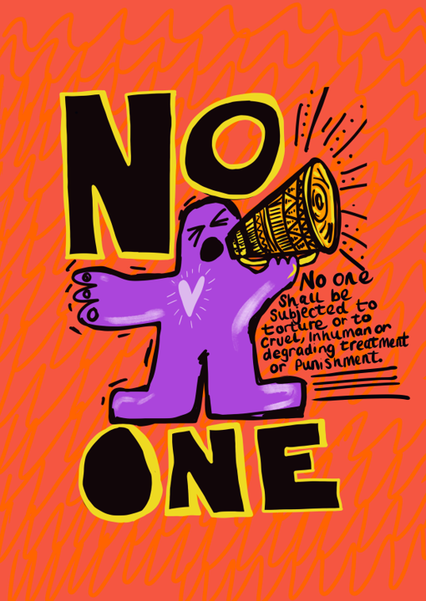

SESSION B:
Article 5; No one shall be subjected to torture or to cruel, inhuman or degrading treatment or punishment
Artwork by Emma Evans

Slide 8
Video Resources for Session B
https://youtu.be/vooZfoRaEG0
Votes for Women: A History of the Women's Suffrage campaign and its legacy at London School of Economics

Slide 9
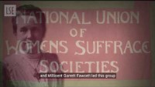

Slide 10
Video Resources for Session B
https://www.youtube.com/watch?v=5rvty0tsEts
Meet the Suffragettes: The Original Media-Disruptors BFI Archives
WARNING: This video does show Emily Wilding Davison at Derby Day.

Slide 11
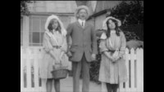

Slide 12
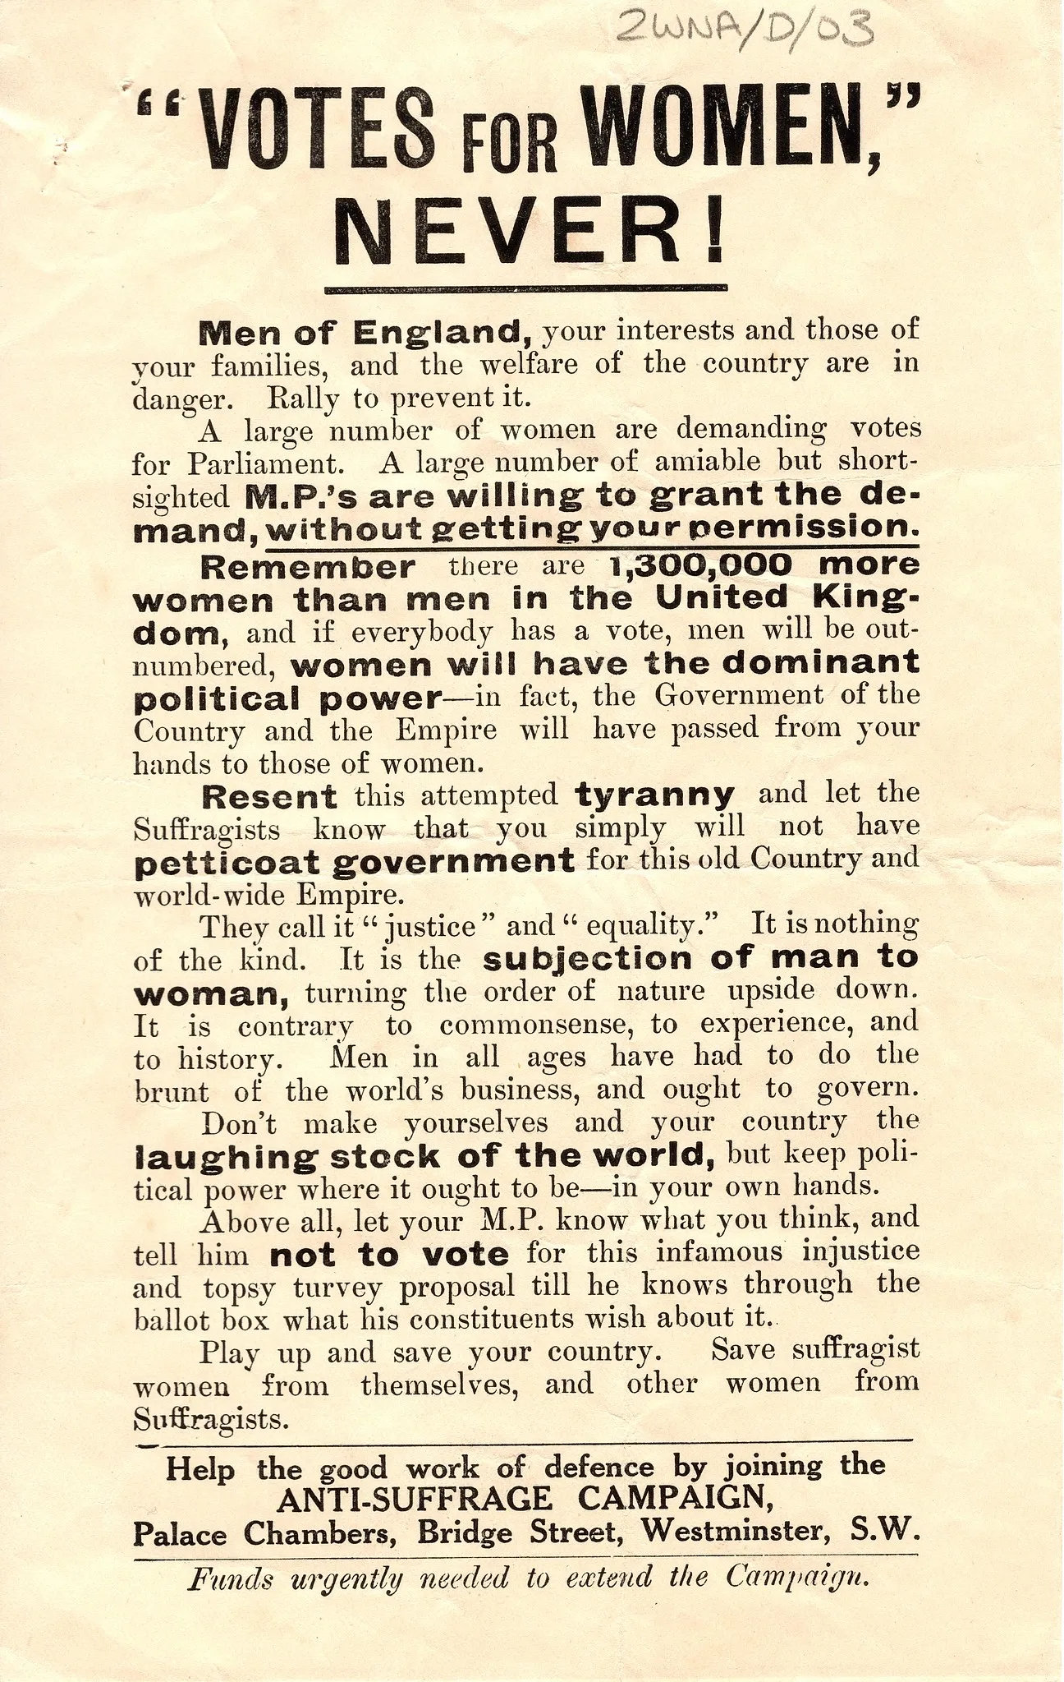

Slide 13
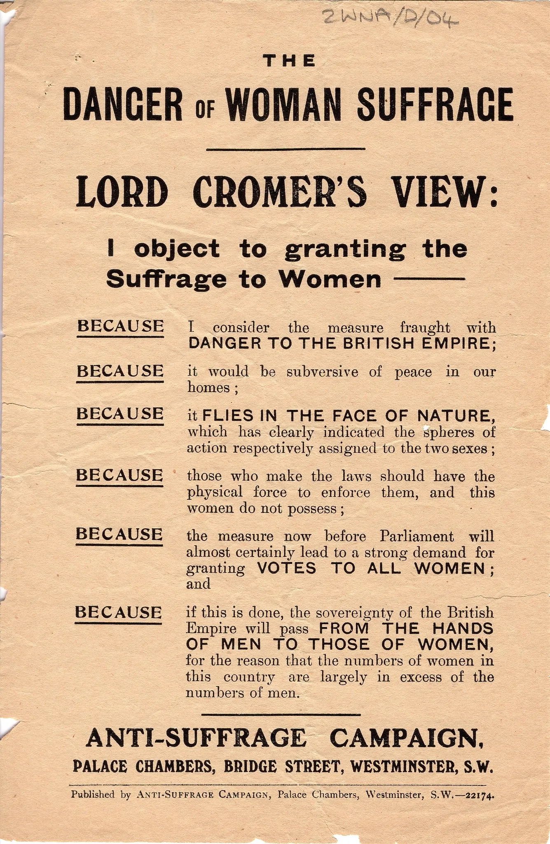

Slide 14
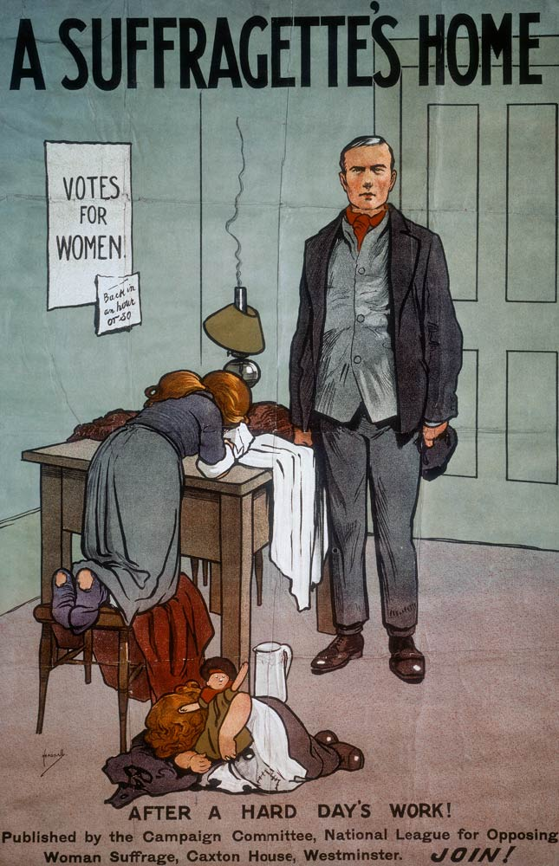

Slide 15
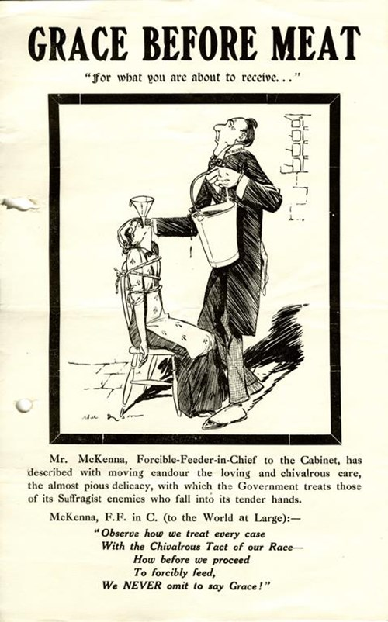

Slide 16

SESSION C:
Article 6; Everyone has the right to recognition as a person before the law
Artwork by Emma Evans

Slide 17
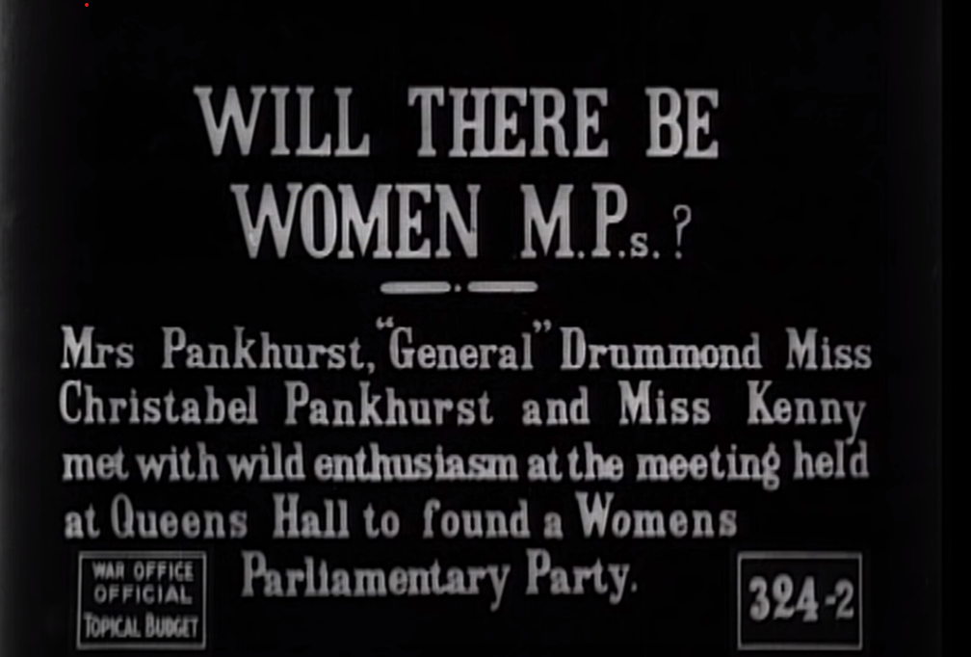

Slide 18
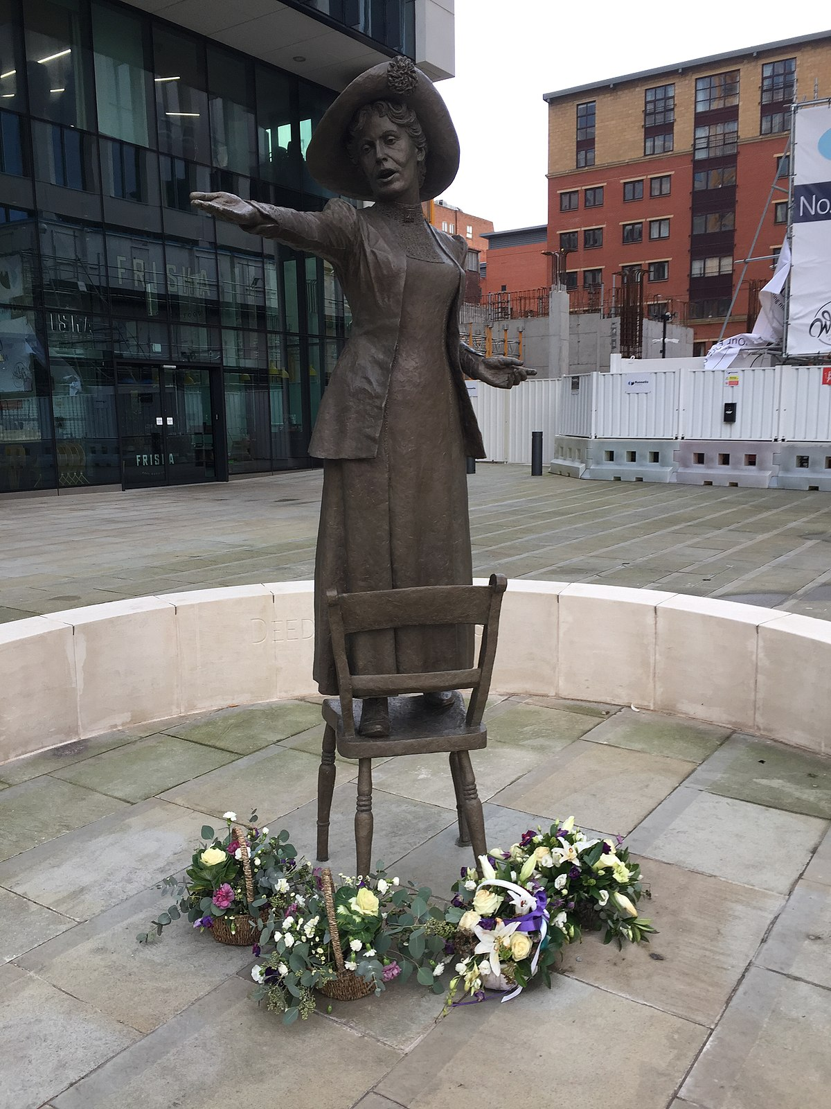
Statue of Emmeline Pankhurst,
St Peter’s Square, Manchester
Emmeline Pankhurst was born in Manchester in 1858.
She was born into a highly educated family. Her grandfather had been present at the Peterloo Massacre.
Her parents were supporters of women’s suffrage. She married Dr Richard Pankhurst in 1879.
In 1903, with her daughter Christabel she held the first meeting of the WSPU, in Manchester.
She turned to more militant tactics and was imprisoned several times.

Slide 19
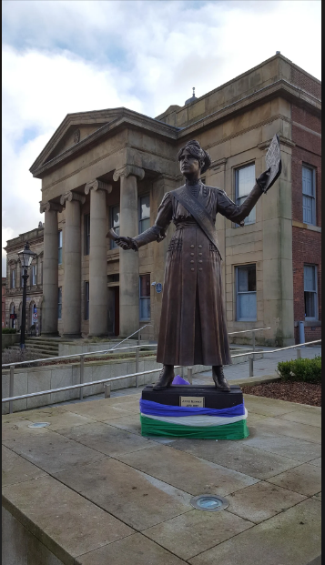
Statue of Annie Kenney,
Oldham, Greater Manchester
Annie Kenney was the fifth of eleven children born to a family of mill workers in Lancashire.
She only attended school for a few years and worked in the cotton mills from the age of 10.
In 1905 she asks a question in Manchester Town Hall of Winston Churchill, “If you are elected, will you do your best to make Women’s Suffrage a government measure?” She is thrown out with Christabel Pankhurst – a policeman claims he has been spat at and they are placed in Strangeways prison for seven days.
She was one of the few working class members of the WSPU so was asked to help run the organisation’s East End branch in London.
She went to prison 13 times for her Suffragette Activism.
In 1912 she defended herself in court with the speech “The Right to Rebel”.

Slide 20
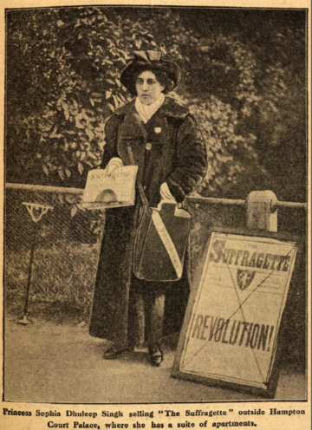
Princess Sophia Duleep Singh
Sophia Duleep Singh was the daughter of the last Maharaja of the Sikh empire in Punjab and god daughter of Queen Victoria.
She was a prominent member of the WSPU and in 1910 led from the front alongside Emmeline Pankhurst. She was part of the protestors who were assaulted by the police on Black Friday, 18 November 1910.
She was not the only Indian suffragette – in 1911 an Indian Women’s Group took part in a march with 60,000 suffragettes.
She was a member of the Women’s Tax Resistance League whose slogan was ‘No Vote, No Tax.’ She was prosecuted several times and some of her valuable possessions impounded.
She would go outside of her apartment at Hampton Court Palace to protest for the right to vote.
The vote was not extended to all women until 1928.

Slide 21
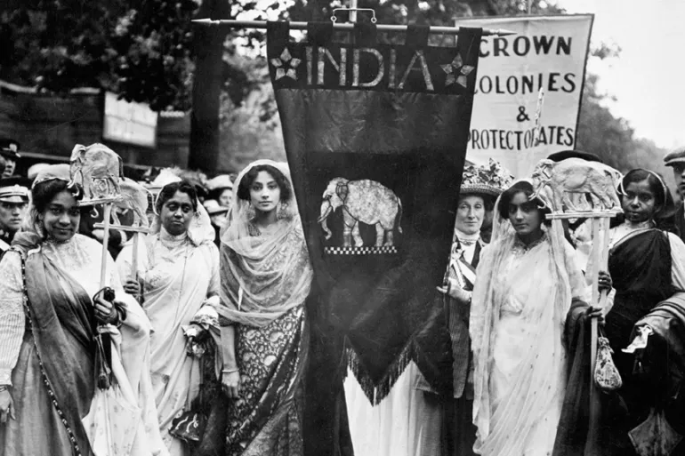

Slide 22
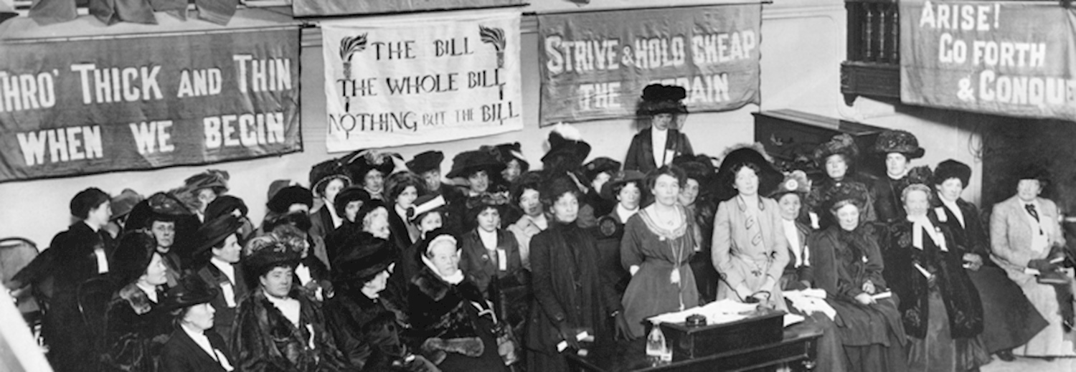

Slide 23
Video Resources for Session
https://youtu.be/2KtNykVXLss
This short video from the Welsh Parliament casts a light on The Women’s Suffrage Movement in Wales.
Although the press focused mainly on the stories of the Suffragettes in London, there were campaigns in Wales with far more suffragists believing in peaceful action and changing things through constitutional means.
The Cardiff District Women’s Suffrage Society was the largest branch of the National Union of Women’s Suffrage Society outside of London.
Most of the women were well-connected, middle class women. Their annual report in 1911 demonstrates that they held a host of activities to raise awareness including fancy dress and a jumble sale.

Slide 24
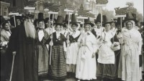

Slide 25
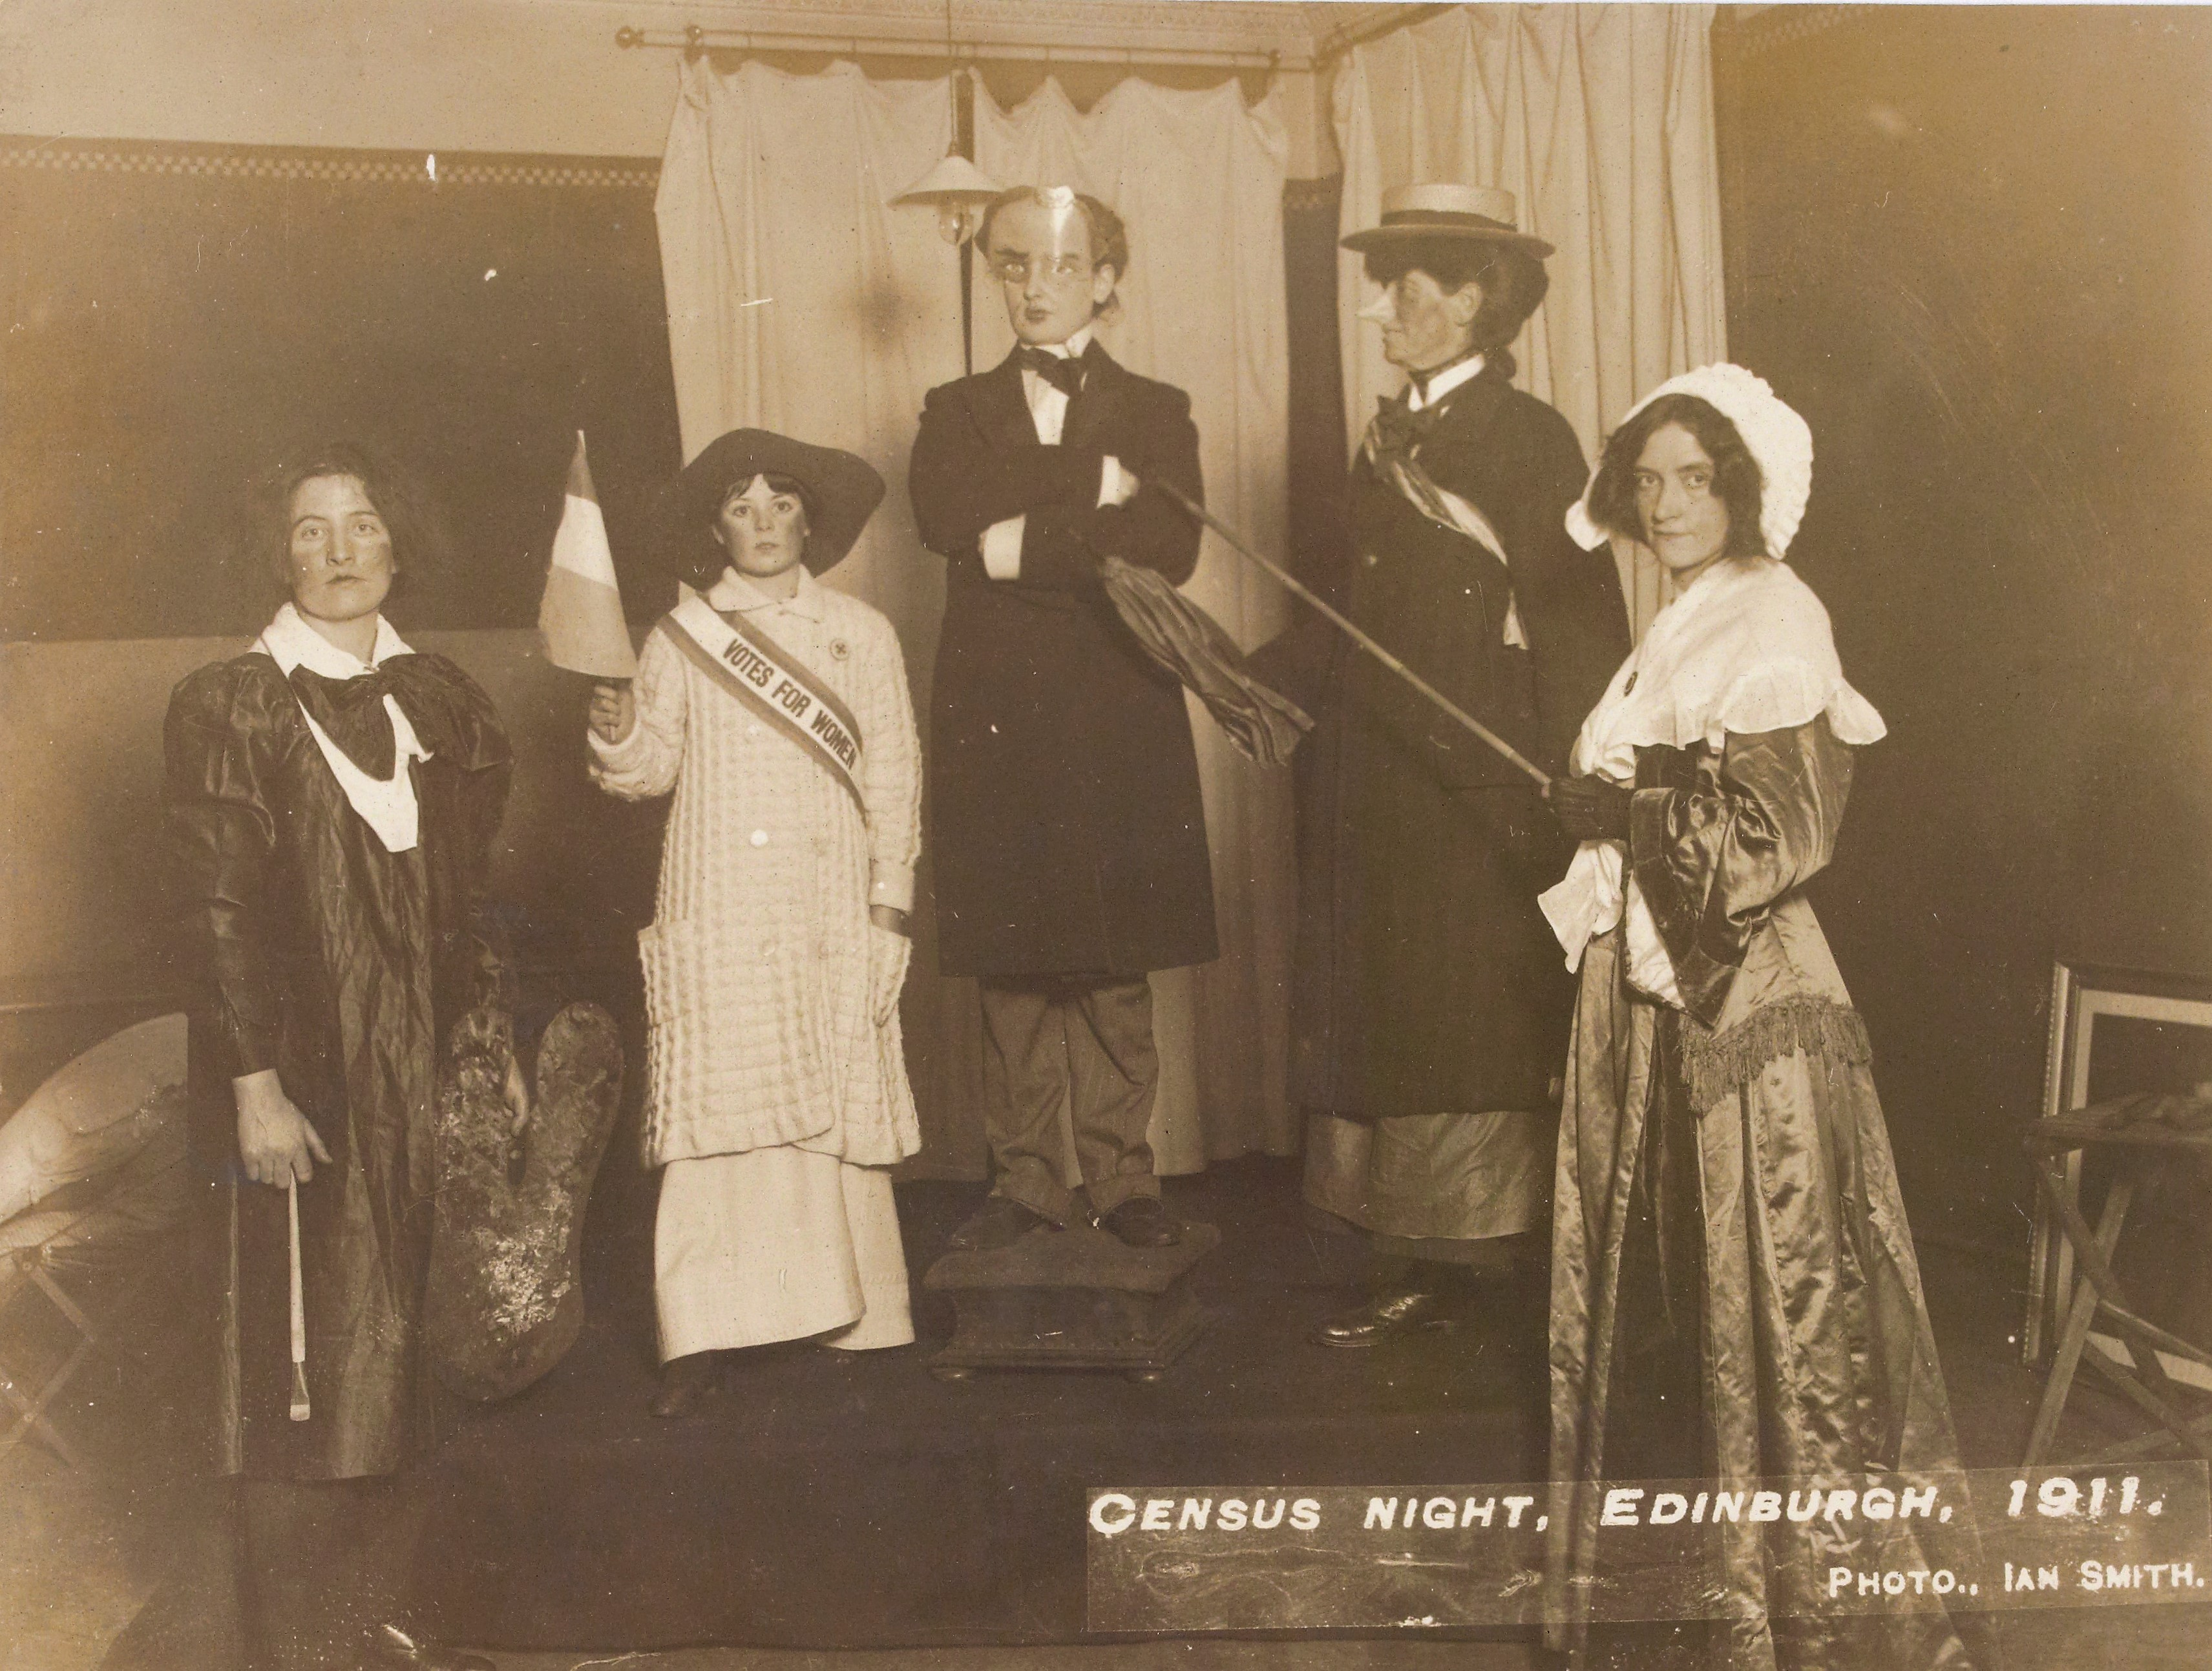
Scotland – National Records Archive
In 1913, Ethel Moorhead was convicted of house-breaking and attempted arson. She was sentenced to eight months imprisonment. In 1914 she became the first woman to be force-fed in Scotland.
Frances Gordon was convicted in Glasgow in 1914. She was sentenced to 12 months imprisonment. It was difficult to force-feed her in the normal way so the doctor chose to feed her ‘per bowel.’ This lasted for four days. On her release, it raised questions in the House of Commons and her appearance was described as “..like a famine victim – her skin brown, the bones of her face projecting, her eyes half closed, her voice a whisper, her lower lip sore, her hands quite cold, her pulse a thread.”

Slide 26
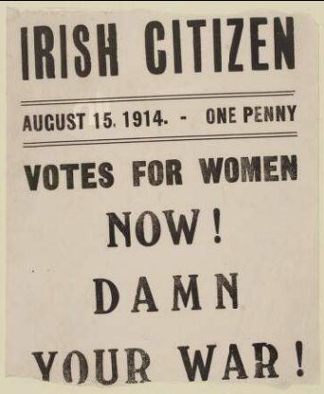
Northern Ireland and
Republic of Ireland
Northern Ireland and Republic of Ireland played a significant part in the women’s suffrage movement. A number of organisations were set up including Northern Ireland Society for Women’s Suffrage in Belfast and the Irish Women’s Suffrage & Local Government Association in Ireland.
One such group was the Irish Women’s Franchise League which was founded by a husband and wife Hanna and Francis Sheehy-Skeffington. They founded the first feminist newspaper in Ireland – the Irish Citizen.
Emmeline and Christabel Pankhurst had a difficult relationship with the suffrage movements in Ireland due to their interference in the fight for Home Rule. Nevertheless, many groups raised the importance of highlighting the welfare of women in Ireland despite the predominant political pressure being on securing or defeating Home Rule.
Countess Markievicz was a key figure in the battle for Home Rule and women’s suffrage. She was the first woman to win a seat at Westminster but refused to take it because of her opposition to the government and refusal to swear allegiance to the King.

Slide 27
SESSION D:
Article 6; Everyone has the right to recognition as a person before the law
Artwork by Emma Evans

Slide 28
Universal Declaration of Human Rights 1948
Article 5: No one shall be subject to torture or to cruel, inhuman or degrading treatment or punishment.
Article 6: Everyone everywhere has the right to recognition as a person before the law.
Article 10: Everyone charged with a crime is entitled to a fair and public hearing by an independent and impartial tribunal.
Article 20: Everyone has the right to freedom of peaceful assembly and association.
Article 21: Everyone has a right to take part in the government of their country. The will of the people shall be the basis of the authority of the government

Slide 29
“… in our civil war people have suffered, but you cannot make omelettes without breaking eggs; you cannot have civil war without damage to do something. The great thing is to see that no more damage is done than is absolutely necessary…..”

Slide 30
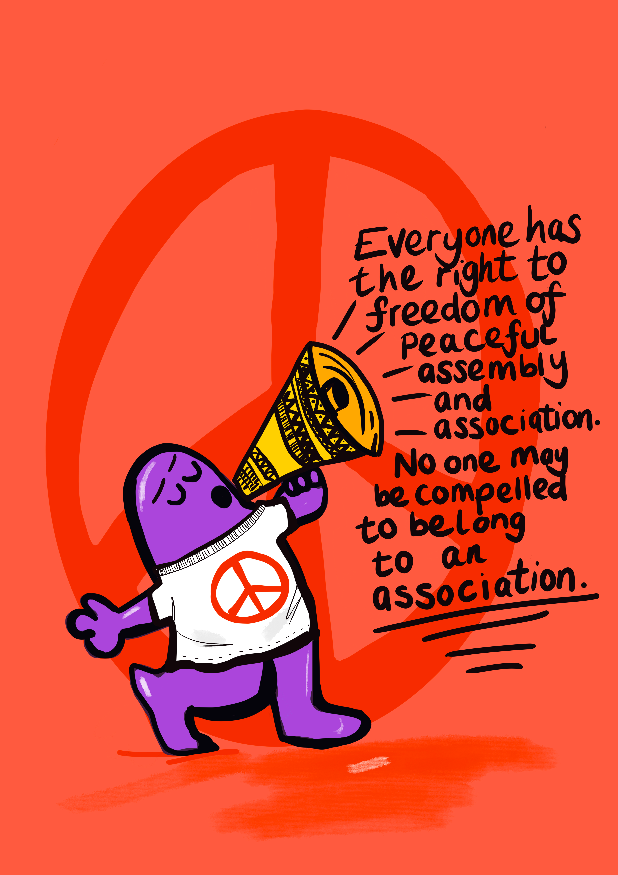
SESSION E:
Article 20; Everyone has the right to freedom of peaceful assembly and association
Artwork by Emma Evans

Slide 31
Militant Action or Terrorism?
Dr Fern Riddell is a historian. In articles held in the National Archives and the British Library she identifies some actions which she believes has not been talked about enough in our history of the suffragettes. She is not passing a judgement on these actions – rather saying we should know and understand that they happened.
Between 1912-1914 militant action reached its peak with regular arson attacks, window-smashing campaigns and targeting of MPs’ houses.
In May 1913 there were 52 attacks, both arson and bombings. People planted bombs that were going to explode later.
They left incendiary devices in churches, in trains and took out the communication from telegraph and telephone wires between London and Glasgow.
They had chemical attacks such as attempting to throw powder that would irritate the eyes, nose and throat at the Prime Minister.
Postmen were injured by the phosphorus that was sent in the post.
In Dublin, three women tried to throw an axe at the Prime Minister.
They believed they were soldiers in a war. They were soldiers. Christabel Pankhurst wrote that, “If men use explosives and bombs for their own purpose, they call it war, and that the throwing of a bomb that destroys other people is then described as a glorious and heroic deed. Why should a woman not make use of the same weapons as men? It is not only war we have declared, we are fighting a revolution.”

Slide 32
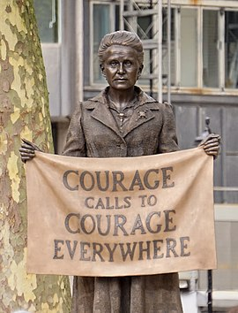
Statue of Millicent Garrett Fawcett,
Parliament Square, London
Millicent Fawcett grew up, like Emmeline Pankhurst, in a highly educated household. Her sister, Elizabeth Garrett became the first woman to gain a medical qualification in the UK.
Millicent married an MP, Henry Fawcett, who believed in women’s suffrage. He was a Cambridge Professor of political economy.
She backed many causes before becoming President of the NUWSS such as curbing child abuse by raising the age of consent.
The NUWSS was the largest of the suffrage societies with more than 50,000 members and was in favour of bringing about change through constitutional change such as lobbying MPs, peaceful marches and petitioning. Some criticism could be that they spent so long lobbying Parliament that the movement sacrificed opportunities to mobilise mass support through the rest of the country.
She was committed to law and order but when WSPU committed militant acts she continued to maintain that the government was responsible for provoking women to break the law and that their sentences were excessive. She was not charismatic like Emmeline Pankhurst but was a persuasive speaker.
Like Emmeline Pankhurst she was a patriot who believed in the war but recognised, through her relationship with the Prime Minister, an opportunity to use the war to negotiate to bring about votes for those men who could not vote and women over the age of 30.

Slide 33
The Action is the Reaction – Matthew Bolton
“If you want change, you need power. You build up power through relationships with other people based on common self-interests. You break the big problems you share down into specific issues – and then you’re ready for action. Action is what turns people power into change.
People often hear ‘action’ and they think ‘protest’. But protest sounds like you’re reacting to someone else’s agenda – they have the power, they are calling the shots, and the people scramble together a protest….Action is different. Action means the people have a plan.”

Slide 34
SESSION F:
Article 6; Everyone has the right to recfreedom of peaceful assembly and association
Artwork by Emma Evans

Slide 35
Links for Session F
https://www.theguardian.com/commentisfree/2023/apr/18/voter-id-poor-marginalised-publicity
https://mcb.org.uk/local-elections-2023-voter-id-and-face-coverings/
https://apnews.com/article/britain-voter-id-law-election-f37dd97f35c9b1cf815ccc87f2a8e016
https://www.historic-newspapers.co.uk/womens-suffrage-timeline/

Slide 36
Barriers that may still exist for Women in Voting
– United Nations Women
Traditional gender roles, gender-based stereotypes and discriminatory attitudes and norms.
Lack of ID and documentation required for voter registration, registration centers that are not accessible, near or open in adequate time and lack of information and awareness about voter registration procedures.
Lack of information and awareness about voting, electoral processes, and overall political rights.
Insufficient targeted civic and voter education programs, or lack of access to existing ones.
Location of polling stations.
Lack of effective procedures to ensure vote secrecy.
Family voting and pressure from family and community on the exercise of their political rights.
Invasive identification procedures (for transgender voters, voters wearing a veil, etc.)
The perception of politics as “dirty”.
Violence from within and outside the household

