Slide 1

Human Rights and Online Misogyny
RFK HUMAN RIGHTS UK
A toolkit for action
Speak Truth To Power

Slide 2


Slide 3

“Plastic has become an integral part of our daily lives”
Sir David Attenborough
Why is plastic such an integral part of our lives?
What else can we not live without?
Should there be guidelines on what we use if it is having an impact on us as individuals and the community?
Is it possible to really bring about change?
What is within our ‘gift’ to change?

Slide 4

“We are at a unique stage in our history. Never before have we had such an awareness of what we are doing to the planet, and never before, have we had the power to do something about that.”
Sir David Attenborough
Listening
Planning
Action
Lobbying
Petitioning
Narrative
Collective
Campaigning
Collaborating
Negotiating
Relationships
Influence
Unifying

Slide 5
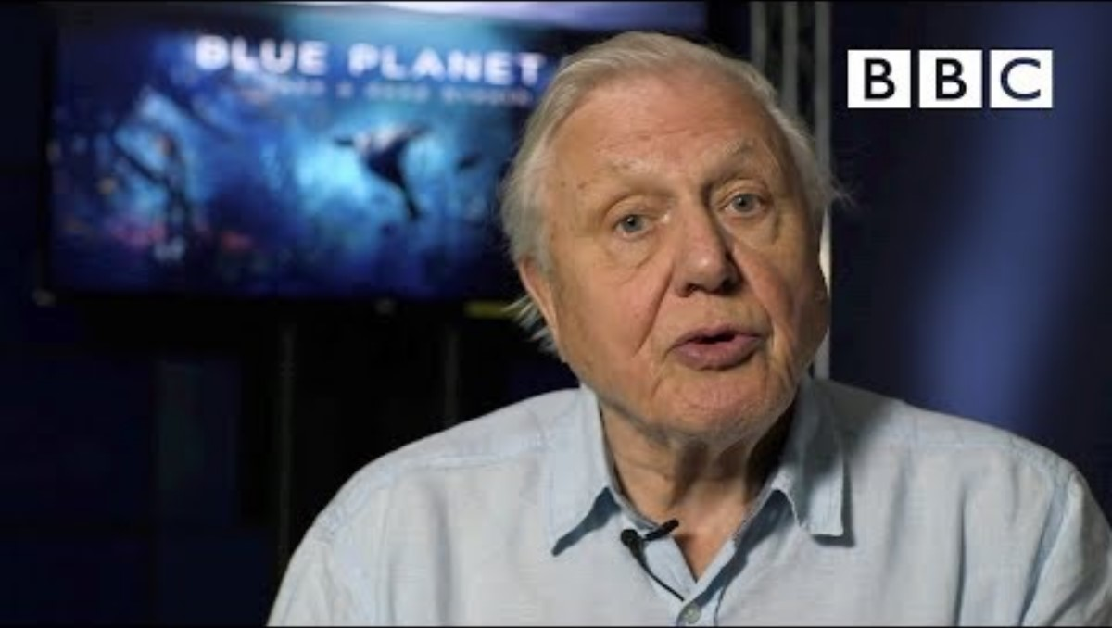

Slide 6
What do you think is meant by a digital polluter?

Slide 7
Who or what pollutes your digital environment?

Slide 8

SESSION B
Online Misogyny

Slide 9
Article 29: Universal Declaration of Human Rights
Everyone has duties to the community in which alone the free and full development of their personality is possible.
In the exercise of his rights and freedoms, everyone shall be subject only to such limitations as are determined by law solely for the purpose of securing due recognition and respect for the rights and freedoms of others and of meeting the just requirements of morality, public order and the general welfare in a democratic society.
These rights and freedoms may in no case be exercised contrary to the purposes and principles of the United Nations.

Slide 10


Slide 11

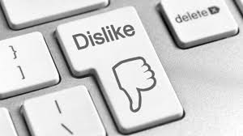

What is misogyny?
Ingrained prejudice, negative opinions, or contempt of women.
Online – this could be:
Stereotype and objectification (a description of women’s physical and/or comparisons to narrow standards)
Dominance (an assertion of the superiority of men over women)
Derailing (abuse of a woman)
Sexual harassment and threats of violence (actions as sexual advances, requests for sexual favours, harassment)
Discredit (slurring over women with no other larger intention).

Slide 12
Does micro-dosing have more of an impact than individual incidents?
Imagine if you were punched randomly by a stranger, how would you feel? What would you do?
Imagine if you were given a dig in the ribs every week by someone you knew? How would this make you feel? What would you do?
Imagine if every day you were tripped up four or five times a day by lots of people you don’t know and people you knew either laughed or ignored it, how would you feel? What would you do?
Imagine if you were told to get back in the kitchen or your opinion didn’t matter online by a stranger, how would you feel? What would you do?
Imagine if every time you went on social media, someone from your extended friendship group commented negatively on your posts, how would you feel? What would you do?
Imagine if every time you went on social media and posted something people you don’t know made negative comments related to the fact you are female and your friends either posted a laughing emoji or joined in, how would you feel? What would you do?

Slide 13
Is misogyny more prevalent online?
A report released by UCL and University of Kent identified that: “our study found that after only 5 days of Tik Tok usage, there was a four-fold increase in the level of misogynistic content being pushed on the “For You” page on Tik Tok.”
They found that there is a direct tracing between how these ideas become part of mainstream youth cultures.
A study commissioned by the Australian government identified that a similar issue was found with You Tube Shorts.
They identified that race and gender clearly influences the content that the algorithms push.

Slide 14
The impact of misogyny online: “There is a degree of aggression and toxicity that you don’t see in real-world encounters.”
As a result, women identify that the level of attacks has a significant negative impact on their mental health, activism, and willingness and ability to express themselves online.
Why is this breaching our Human Rights and in particular Article 29?
A report in 2014 from the UK government on tackling Violence against Women and Girls identified that, “Violence against women and girls (VAWG) is one of the most widespread abuses of human rights worldwide, affecting one third of all women in their lifetime…..Violence against women and girls is a fundamental barrier to eradicating poverty and building peace. Even the most conservative estimates measures national costs of violence against women and girls in the billions of dollars.”
If this was identified in 2014, what do you think may be the reasons it is so prevalent now online?
Who is benefiting from this?

Slide 15
SESSION C
The Impact

Slide 16
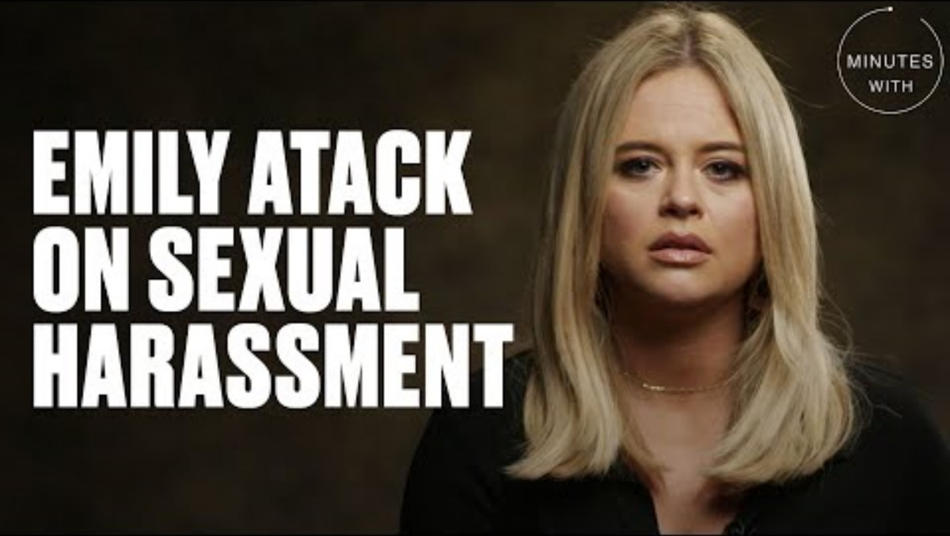
Notes:
This video contains sexist and abusive language.

Slide 17
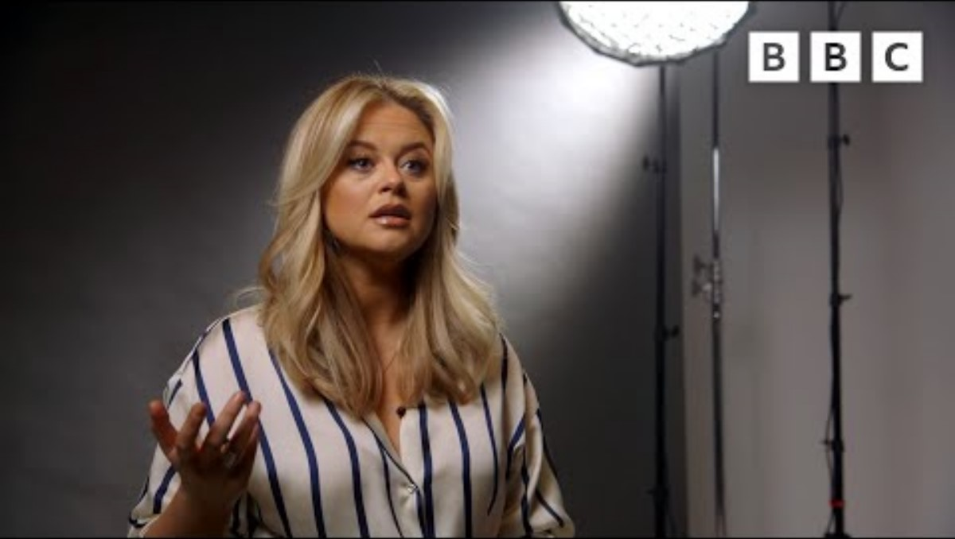
Notes:
Bad language is blanked out in this.

Slide 18
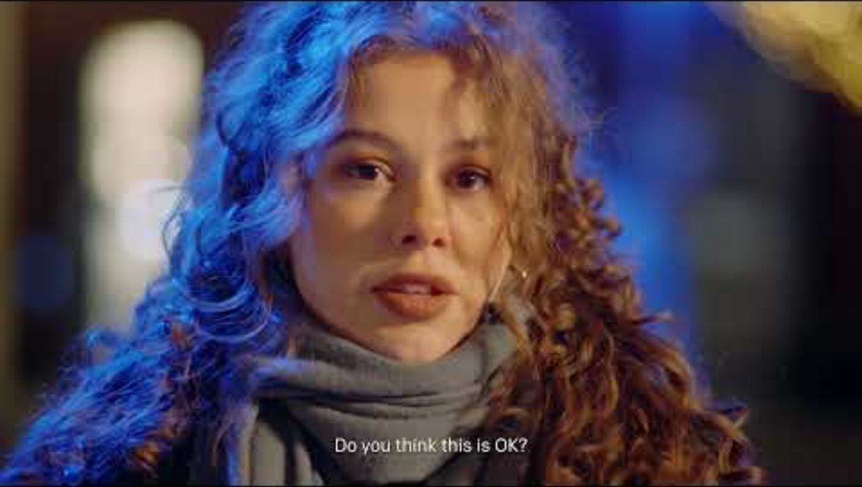

Slide 19
Untrustworthy | Unqualified | Unintelligent | Unlikable

Slide 20
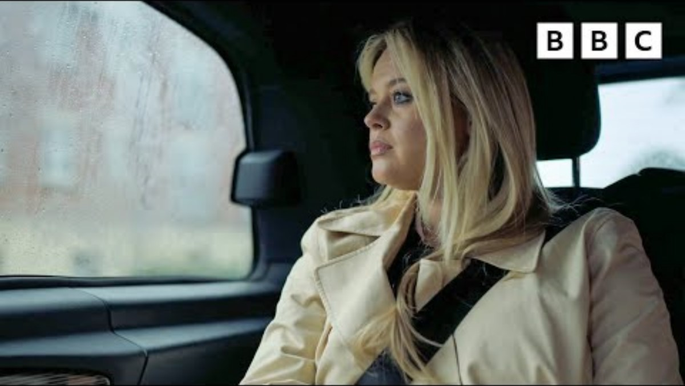
Notes:
Talking about what we can do

Slide 21
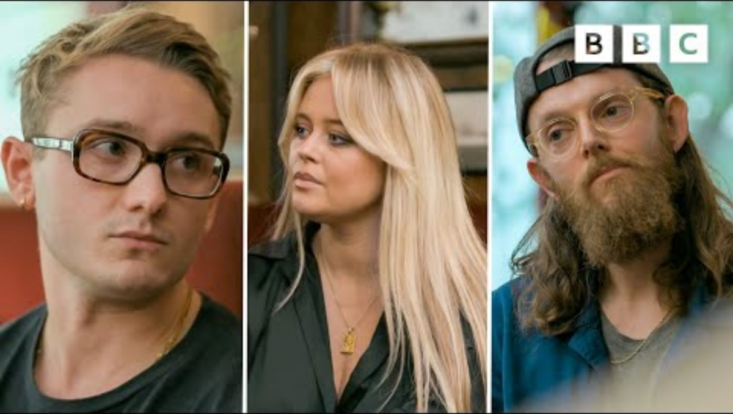

Slide 22
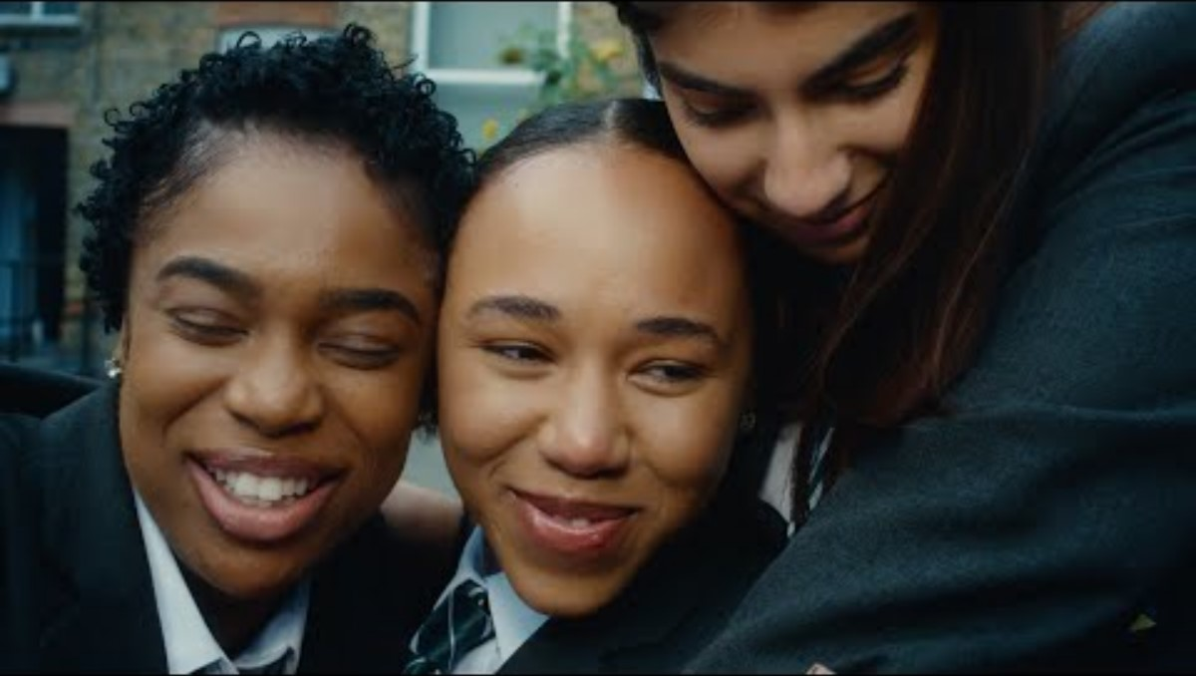

Slide 23
SESSION D
Active Bystander

Slide 24
Being an Active Bystander
Distract
Delegate
Document
Delay
Direct
First of all, online, we have to notice. Once we’ve done this we have to determine if there is a need for action.
Secondly, we have to show empathy – we may not know the person but remember from our work the impact that online misogyny has on an individual.
Finally, when we’ve decided to act we need to know which aspect of the Active Bystander programme we need to use.

Slide 25
What are our roles online?
The bully – begins the process of making a female uncomfortable online. This could be through:
a) stereotyping or objectifying
b) dominating the conversation
c) derailing the conversation through abusing a female
d) sexually harassment
e) discrediting the female: maybe they suggest they are untrustworthy, or unqualified, or unintelligent or unlikable
Often they do this through the use of humour or banter to get likes and emojis.
Notes:
Ingrained prejudice, negative opinions, or contempt of women.
Online – this could be:
Stereotype and objectification (a description of women’s physical and/or comparisons to narrow standards)
Dominance (an assertion of the superiority of men over women)
Derailing (abuse of a woman)
Sexual harassment and threats of violence (actions as sexual advances, requests for sexual favours, harassment)
Discredit (slurring over women with no other larger intention).

Slide 26
What are our roles online?
The assistant – they may not start it but they join in. They might exacerbate what the bully is saying. They might put the woman down by telling them it’s only a joke or using sexist language. They might share with wider groups of people.
The reinforcer – they may not say anything but they come around for a watch or a laugh. They might use likes, emoticons or comments.
The outsiders – they might see what’s going on but choose not to get involved.
The defenders – they notice what is going on, feel empathy and a moral responsibility for what is taking place. They choose what intervention they are going to use and take action.
Notes:
Ingrained prejudice, negative opinions, or contempt of women.
Online – this could be:
Stereotype and objectification (a description of women’s physical and/or comparisons to narrow standards)
Dominance (an assertion of the superiority of men over women)
Derailing (abuse of a woman)
Sexual harassment and threats of violence (actions as sexual advances, requests for sexual favours, harassment)
Discredit (slurring over women with no other larger intention).

Slide 27
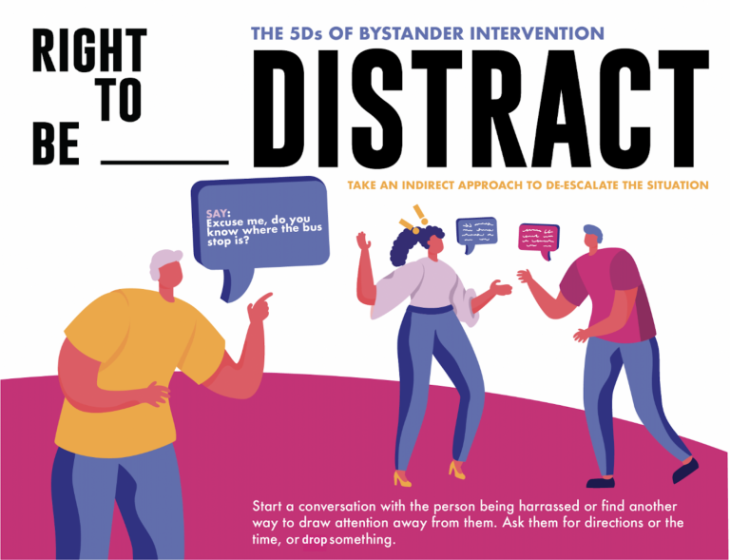
Notes:
Images from Right to Be: https://righttobe.org/guides/bystander-intervention-training/

Slide 28
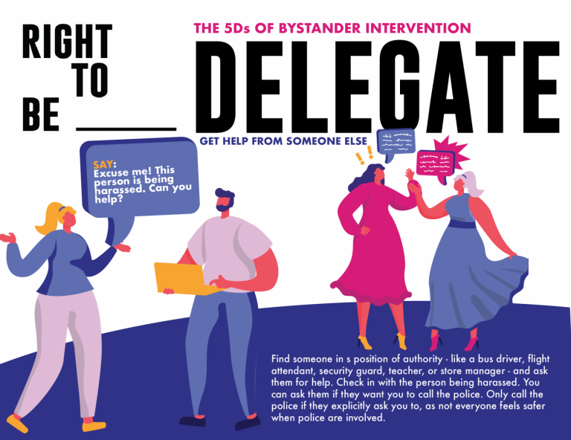

Slide 29
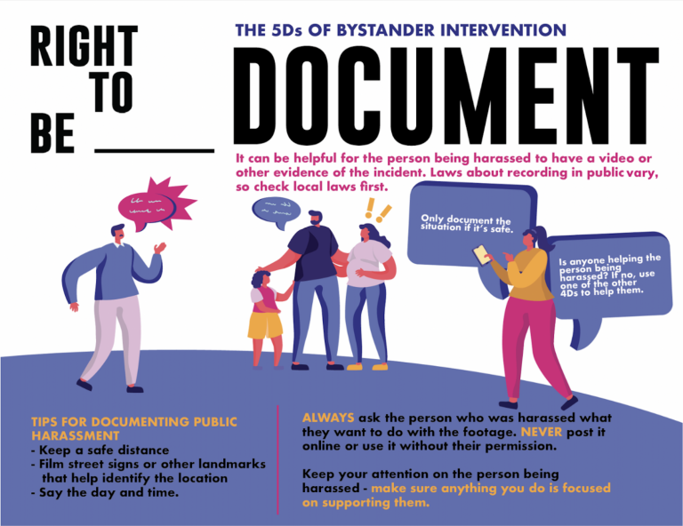

Slide 30
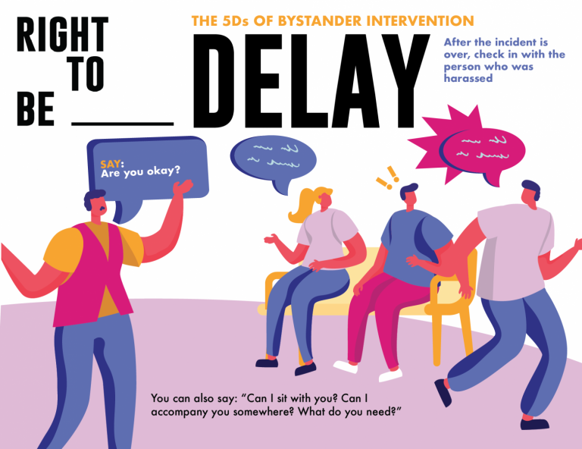

Slide 31
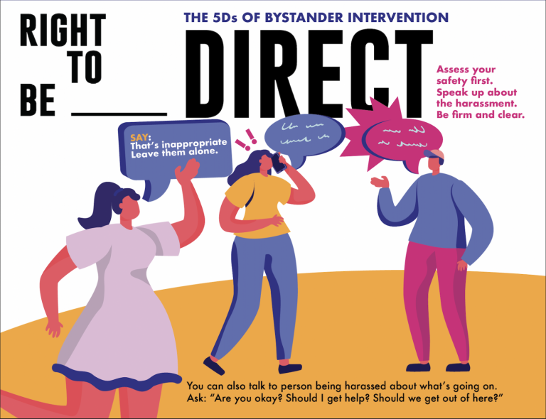

Slide 32
GLOSSARY
Useful terminology

Slide 33
Misogyny – reports state that whilst we use this term freely as professionals, only 29% of 15-16 year olds understood the term compared to 46% who have little to no understanding. It’s important then that we are very clear then that we are teaching explicitly what this means.
Misogyny in our Scheme of Learning means: ingrained prejudice, negative opinions, or contempt of women. We should be able to give guidance what this means and what it looks like online:
Stereotype and objectification (a description of women’s physical and/or comparisons to narrow standards
Dominance (an assertion of the superiority of men over women)
Derailing (abuse of a woman)
Sexual harassment and threats of violence (actions as sexual advances, requests for sexual favours, harassment)
Discredit (slurring over women with no other larger intention).
In addition, we should identify that some of the attacks are focused around the idea that women are untrustworthy, unqualified, unintelligent, unlikable.

Slide 34
Language from the manosphere is also useful to be aware of. This terminology comes from the document Safer Scrolling embedded within this slide deck.
Incel: short for involuntary celibates, incel refers to a person, usually a man, who expresses resentment, rage and hostility towards women for denying them relationships and sex. The term originally emerged in online subcultures, with men fantasising and sharing dark humour about violence against women.
Algorithm: a computer-generated set of rules and data that control how content (such as videos, users or posts) are filtered and recommended to users on the platform.
Hegemonic masculinity: the ideology that men should be dominant in society at the expense of the subordination of women.
Hyper masculinity: exaggerated image of masculinity which overemphasises the ideals, such as physical strength, aggression and sexuality set out for men, thereby reinforcing them.
Red pill: Concept of ‘red pill’ originated on incel forums, and are a self-identified group that take the view that society is dominated by women but individual attempts such as learning ‘game’ or improving your appearance can lead you to achieve a sexual relationship with women.
Black pill: Concept of ‘black pill’ originated on incel forums. Unlike Red Pills, Black Pillers believe that looks and relationships are genetically pre-determined, and that there are wider societal barriers to relationships. Black pillers believe that women only care about men’s physical looks, and that no individual actions will ever improve their chances of having a sexual relationship.

Slide 35
Manosphere: umbrella term that refers to content, communities, forums and websites that promote masculinity, men’s rights and oppose women’s rights and feminist movements.
Looksmaxing: physical improvement of someone’s body and appearance, such as through plastic surgery, diet, exercise or skin care.
Sigma male: slang term used to describe a popular, successful but hugely independent and self- reliant man. Another term is a lone wolf.

Slide 36
Sexist Language – language which denigrates girls and femaleness. Associating negative language with females i.e. ‘pussy’, ‘man-up’. It can be misogynistic as in demonstrating a hatred of women. It can reinforce historical cultural norms which are not aligned with the Equality Act of 2010 and Protected Characteristics i.e. women shouldn’t work, women should just do housework. There is a close link to homophobic language and the language does not have to be targeted at women and girls.
Dead naming and misgendering – intentionally using a previous name which a transgender person has left behind or using the wrong pronouns deliberately.
Sexual harassment – can be ‘stand alone’ and can be verbal and non-verbal. Could be sexual comments, upskirting or unwanted sexual touching.
Sexual assault - When a person doesn’t consent to sexual touching and perpetrator does not reasonably believe that they consent this is sexual assault. Consent is having the freedom and capacity to choose between one sexual act and another and to stop at any time. A child under 13 can never by law consent. The age of consent is 16. Sexual intercourse without consent is rape.
Online sexual harassment – non-consensual sharing of intimate images and videos; a person’s sexual images and videos being shared without their consent or taken without their consent.
Exploitation, coercion and threats – a person receiving sexual threats being coerced to participate in sexual behaviour online or offline or being blackmailed with sexual content. Unhealthy relationships between peers sometimes have an element of coercion. These relationships may become exclusive to others, there may be a physical element of control.
Sexualised bullying – a person being targeted by and systematically excluded from a group or community with the use of sexual content that humiliates, upsets or discriminates against them.
Unwanted sexualisation – unwelcome sexual requests, comments or content.
Victim blaming and slut-shaming – blaming a victim for what has happened, discarding the experience, using derogatory language to blame a victim or encouraging others to engage in the name-calling.

