Slide 1

Year 6 – LGBTQ+
RFK HUMAN RIGHTS UK
Session 3 & 4
Speak Truth To Power

Slide 2


SESSION 2:
Based on Article 12 of the UN Convention of the Rights of a Child; Every child has the right to express their views, feelings and wishes in all matters affecting them, and to have their views considered and taken seriously. This right applies at all times.

Slide 3
What does this mean? Discuss with your partner

Slide 4
WHO DO WE NEED TO MAKE CHANGE?
HOW CAN YOU MAKE A DIFFERENCE?

Slide 5
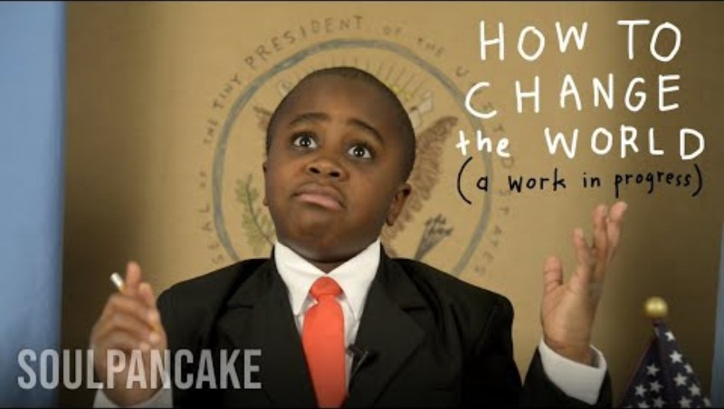

Slide 6
WHO DO WE NEED TO MAKE CHANGE?
Examples of Human Rights Campaigns.
What will your campaign be?

Slide 7
APPROACHES FOR CHANGE:
BOYCOTT – Animal Testing
PROTEST – Climate Change (Extinction Rebellion), Black Lives Matter
CHANGE LIFESTYLE – Recycling, Learning, Shopping Choices
WRITING LETTERS – Lobbying political figures to use their power for change
ART – Art can make people pay attention to important messages

Slide 8
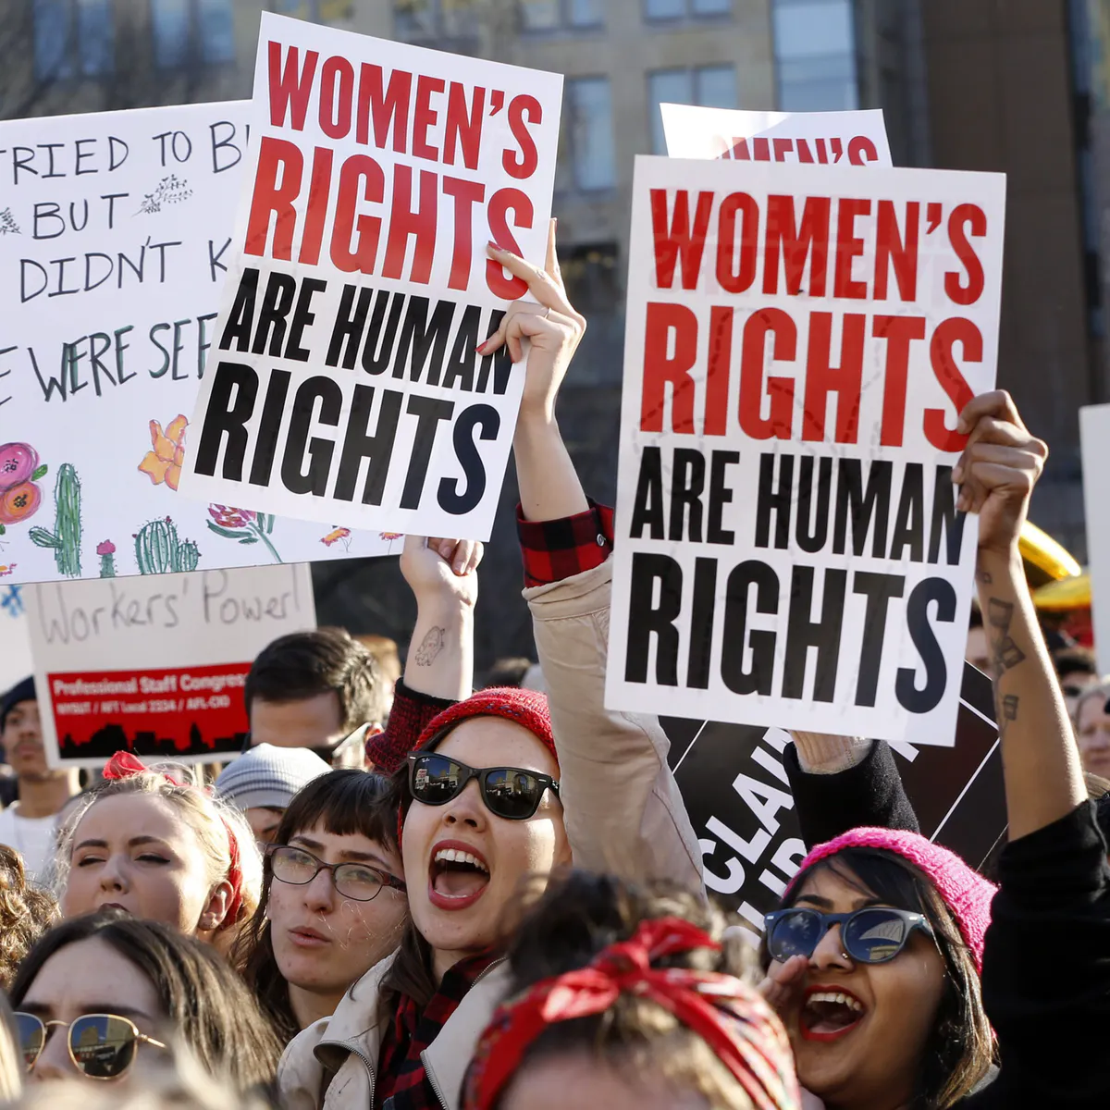
PROTEST

Slide 9
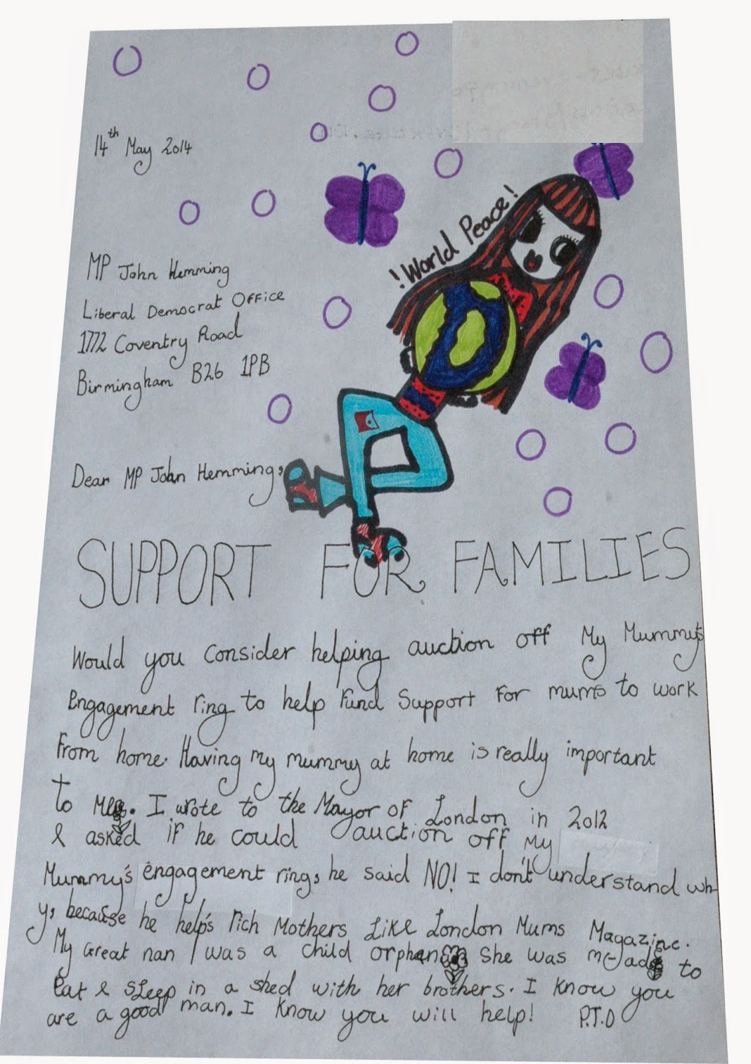
WRITE LETTERS TO YOUR LOCAL MP

Slide 10
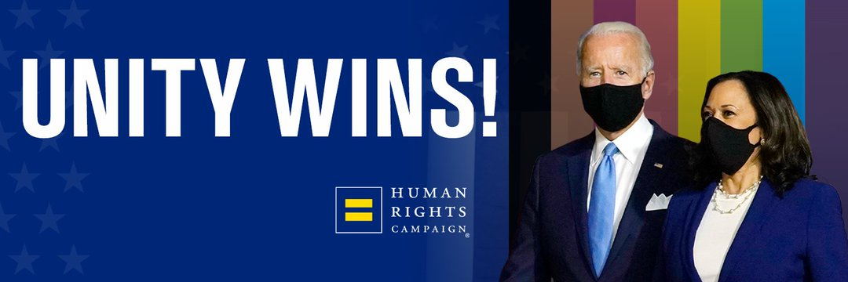
TWITTER CAMPAIGNS

Slide 11
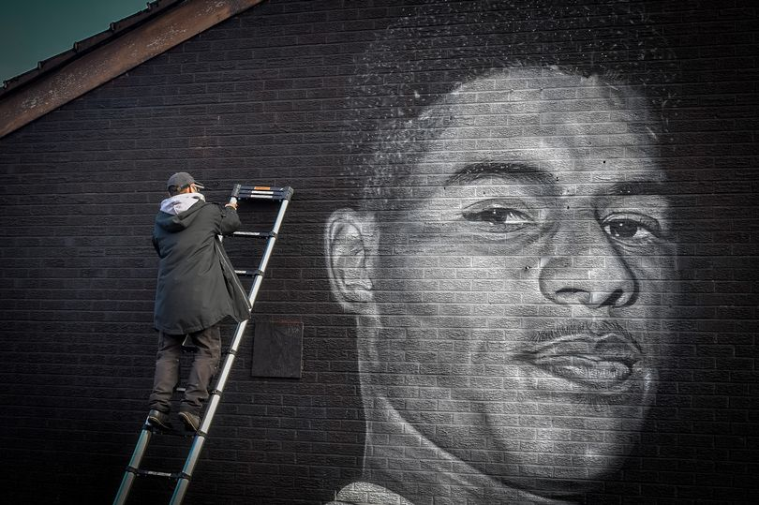
CAMPAIGN THROUGH ART

Slide 12
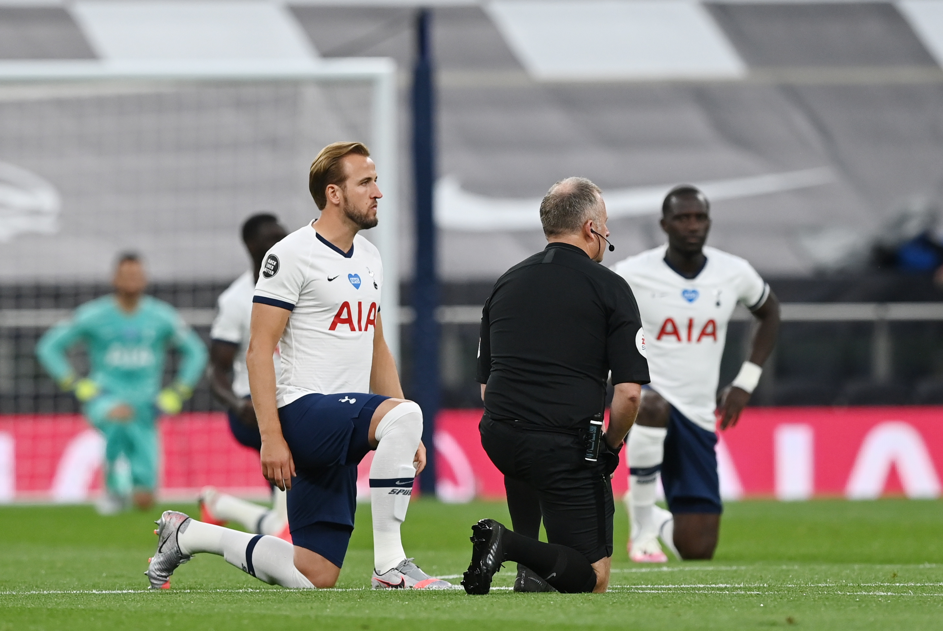
CAMPAIGN THROUGH ACTIONS

Slide 13
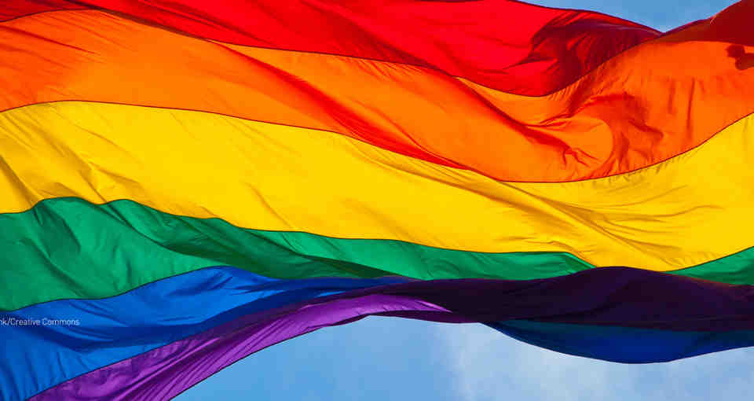
START A NEW PROJECT THAT WILL HIGHLIGHT THE ISSUE

Slide 14
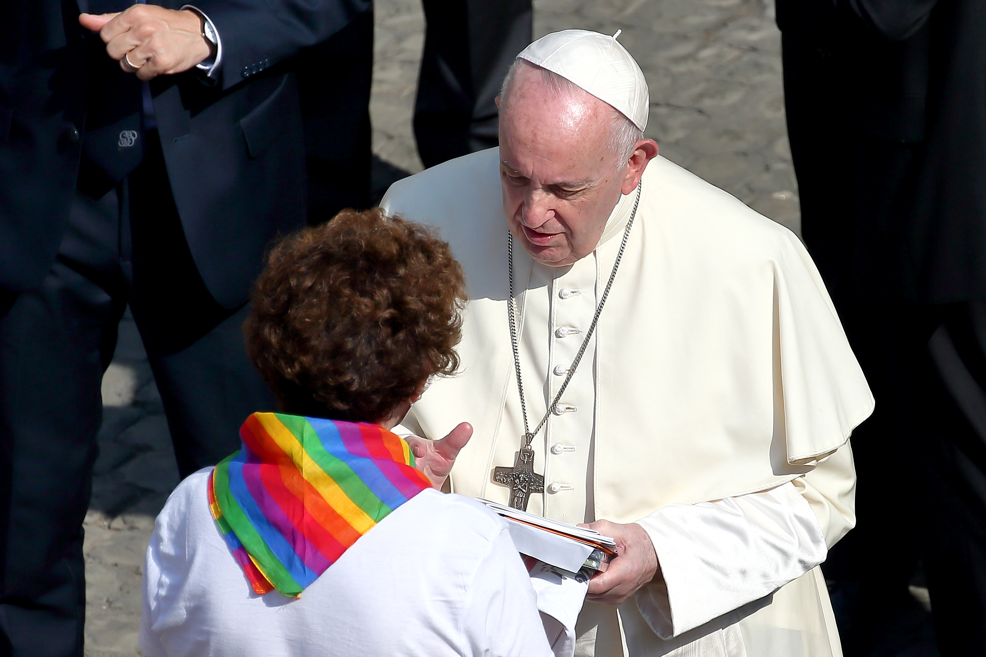

Slide 15
HOW CAN YOU MAKE CHANGE?
In pairs discuss which campaign you believe is the most effective and why?

Slide 16
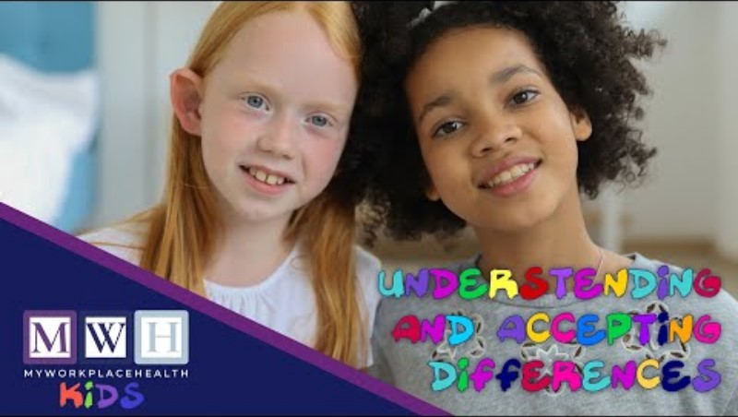

Slide 17
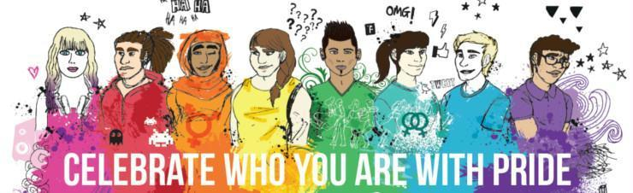
HOW CAN YOU MAKE CHANGE?
Create your ‘EQUALITY’ wallpaper campaign for LGBTQ+ Rights, celebrate how we are all unique and we should celebrate our differences

Slide 18
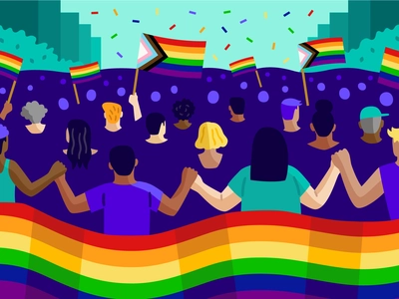
HOW CAN YOU MAKE CHANGE?
We accept people for they are.

Slide 19
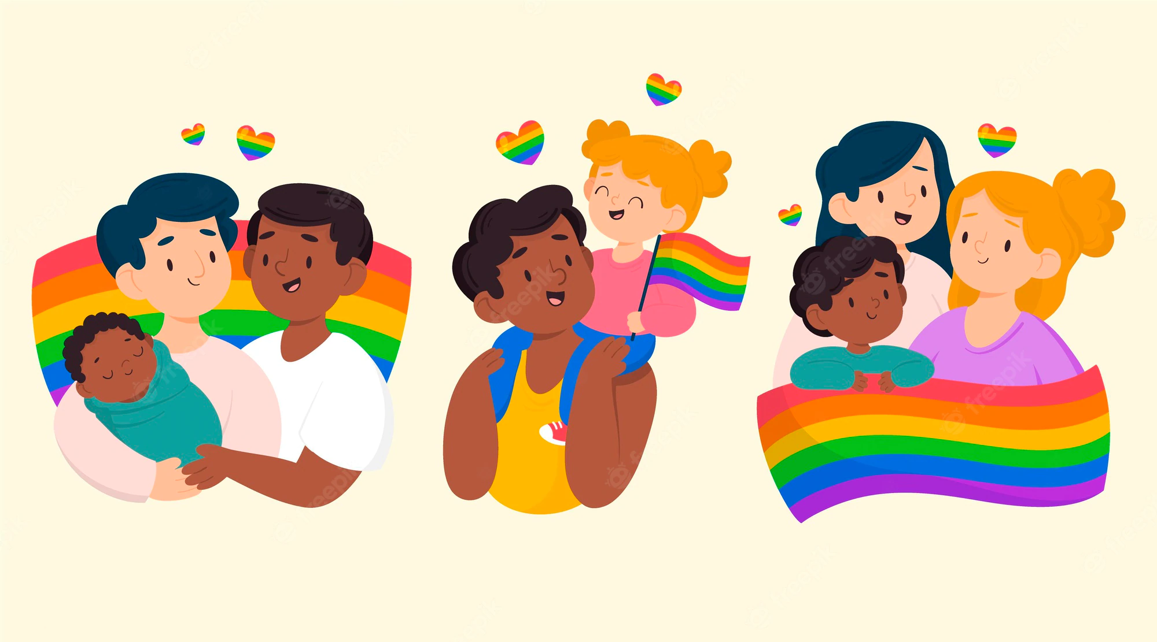
HOW CAN YOU MAKE CHANGE?
We are all unique and loved.

Slide 20
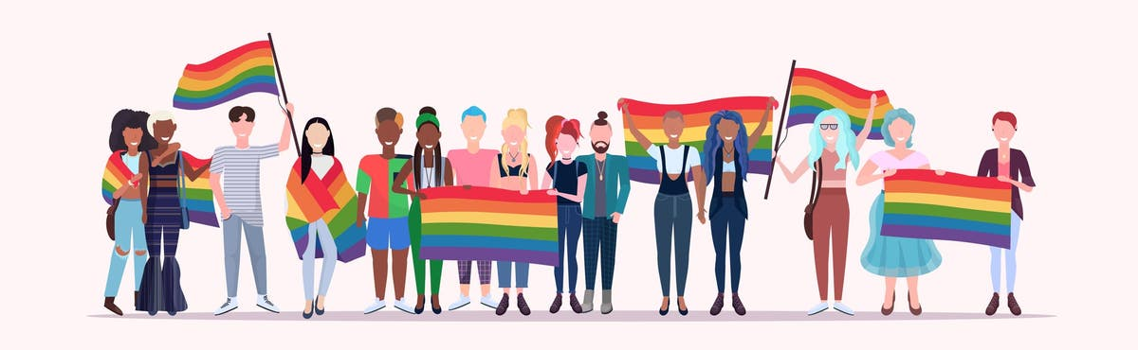
HOW CAN YOU MAKE CHANGE?
Collaboratively create your 4metre poster campaign.
Create self portraits to show how you are all different.
How will you share this on social media to celebrate difference?

Slide 21


Slide 22
WHAT DID I LEARN?
What was your favourite part of the lesson and what did you find challenging? Why?
In an ideal world change rarely happens straight away. What can you do to make change happen?
We can sometimes think that the heroes we know about are the only people making changes. Is this true? Why?

