Slide 1

Year 5 – Systemic Racism
RFK HUMAN RIGHTS UK
Session 2
Speak Truth To Power

Slide 2


SESSION 2:
Based on Article 12 of the UN Convention of the Rights of a Child; Every child has the right to express their views, feelings and wishes in all matters affecting them, and to have their views considered and taken seriously. This right applies at all times.

Slide 3
Who and what make Movements for Change happen?

Slide 4
CHANGEMAKERS

Slide 5
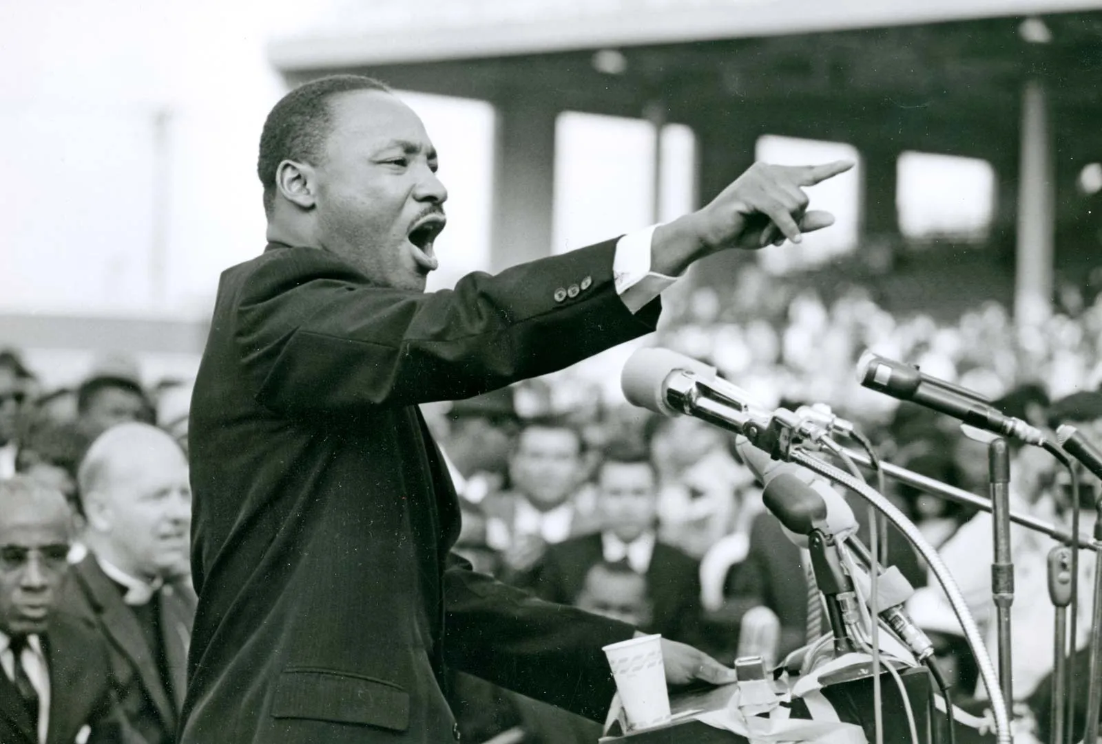
Who Am I? How Did I Make a Difference?

Slide 6
Martin Luther King – Human Rights Activist, Campaigner for Equality

Slide 7
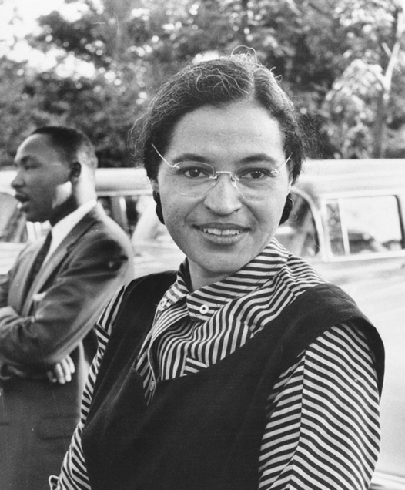
Who Am I? How Did I Make a Difference?

Slide 8
Rosa Parks, Human Rights Activist & Campaigner for Equality

Slide 9
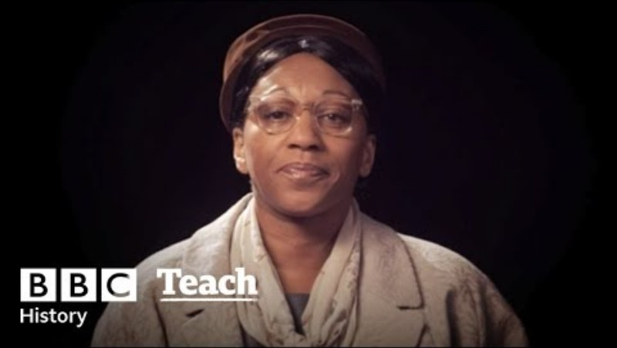

Slide 10
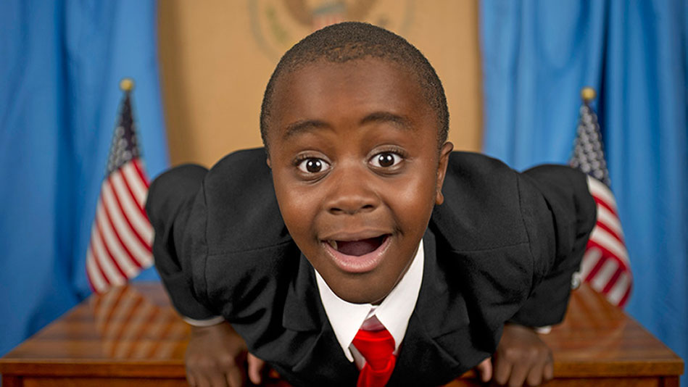
Who Am I? How Did I Make a Difference?

Slide 11
Robby Novak – Campaigner for Children’s Rights Equality

Slide 12
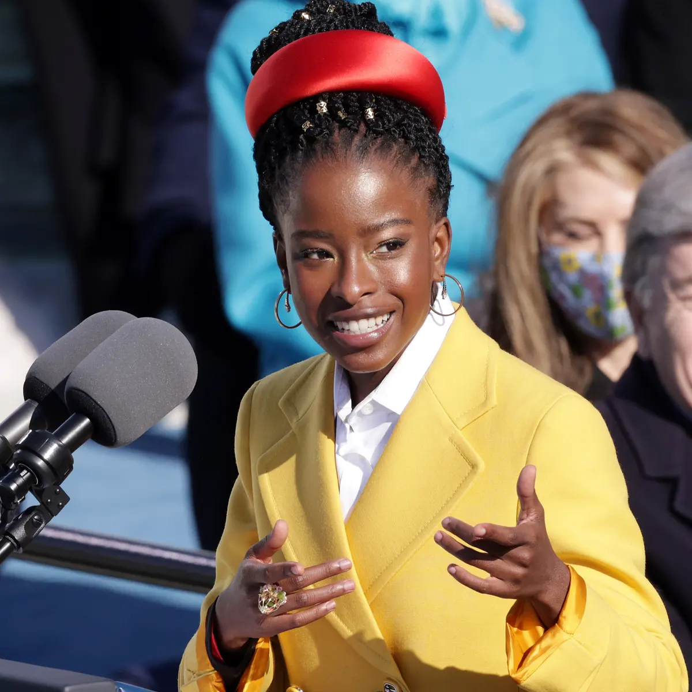
Who Am I? How Did I Make a Difference?

Slide 13
Amanda Gorman – Human Rights Activist, Campaigner for Equality

Slide 14
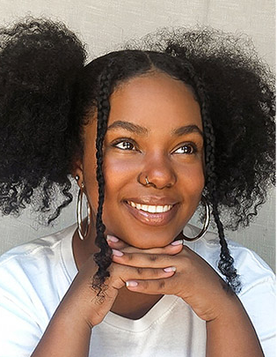
Thandiwe Abdullah – Activist for Equality
Watch this Video:
https://www.youtube.com/watch?v=kYVKCKyJe58

Slide 15
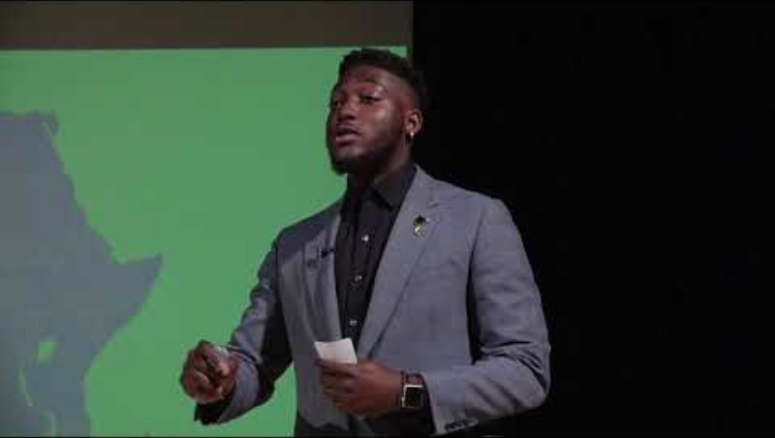
Watch this video

Slide 16
What kind of skills and qualities did these Human Rights heroes have?
Discuss

Slide 17
What did the Human Rights heroes do to create the movement they were involved in?
Discuss.

Slide 18
Do Human Rights heroes make change on their own?
Discuss.

Slide 19
What kind of people do we need to make Change?
Discuss.

Slide 20

Create your Human Rights Creative Mind map

Slide 21
What Did You Learn?

