Slide 1

Year 4 – Gender Equality
RFK HUMAN RIGHTS UK
Session 3 & 4
Speak Truth To Power

Slide 2


SESSION 3 & 4:
Based on Article 4 of the UN Convention of the Rights of a Child; Governments must do all they can to make sure every child can enjoy their rights by creating systems and passing laws that promote and protect children’s rights.
What does this mean to you? Discuss with your partner.

Slide 3
Who do we need to make Change? How can you make a difference?

Slide 4
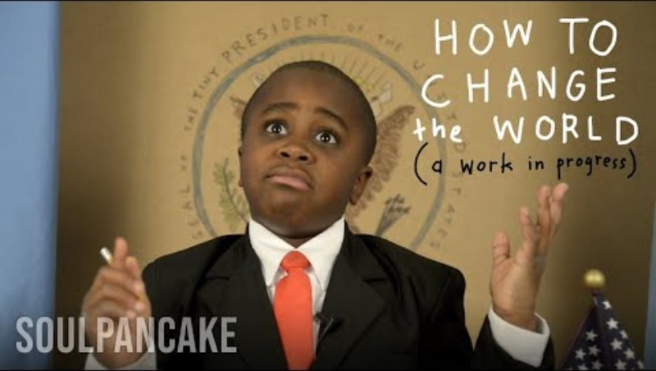

Slide 5
WHO DO WE NEED TO MAKE CHANGE?
Examples of Human Rights Campaigns.
What will your campaign be?

Slide 6
APPROACHES FOR CHANGE:
BOYCOTT – Animal Testing
PROTEST – Climate Change (Extinction Rebellion), Black Lives Matter
CHANGE LIFESTYLE – Recycling, Learning, Shopping Choices
WRITING LETTERS – Lobbying political figures to use their power for change
ART – Art can make people pay attention to important messages

Slide 7
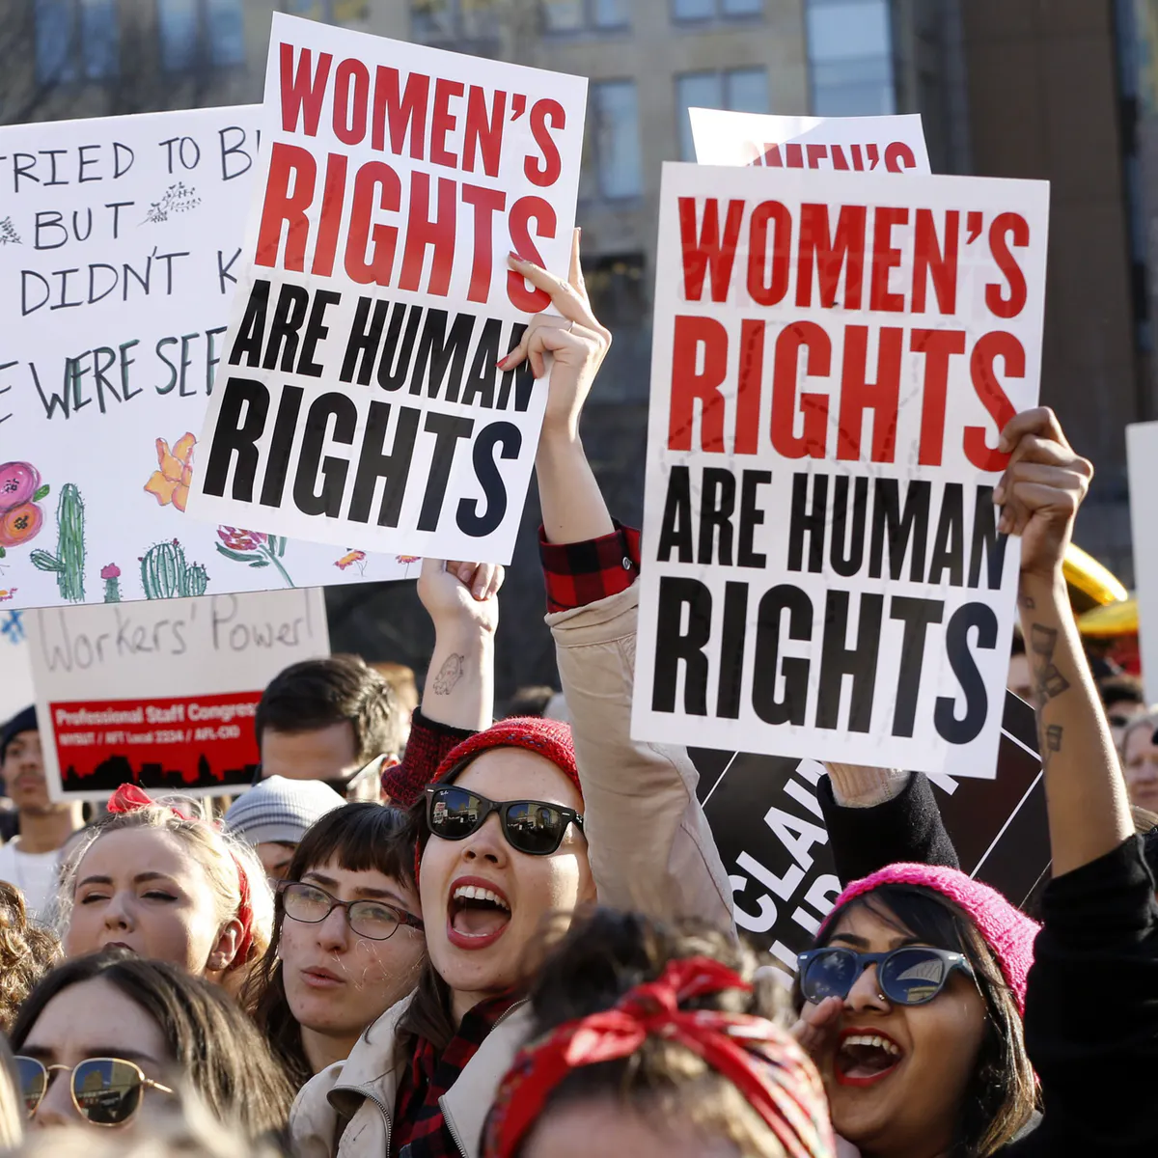
PROTEST

Slide 8
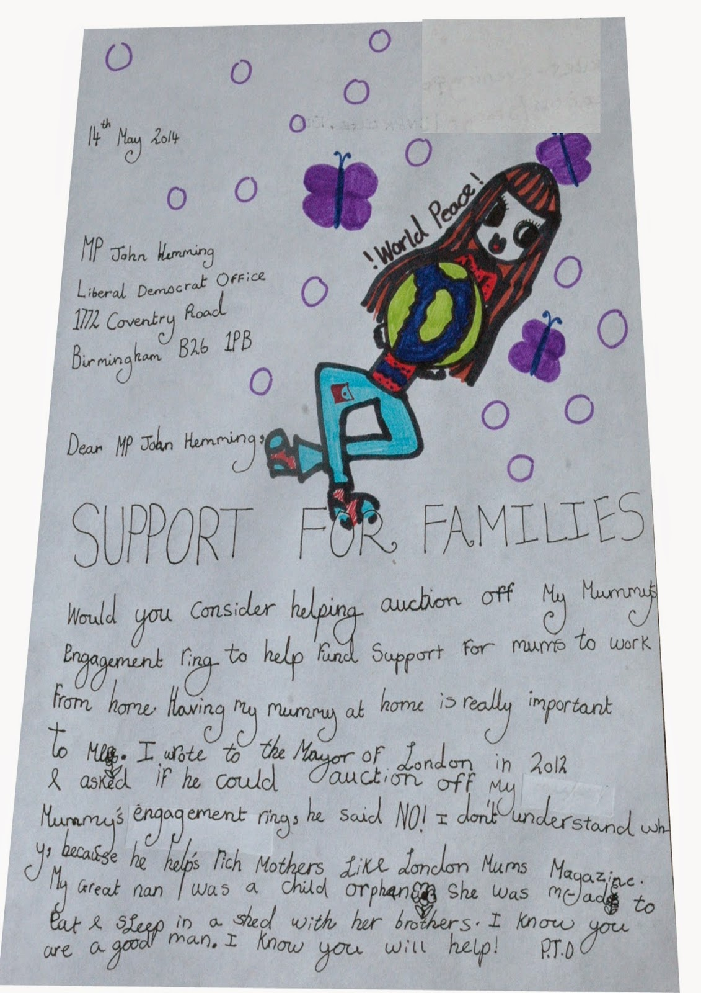
WRITE LETTERS TO YOUR LOCAL MP

Slide 9

TWITTER CAMPAIGNS

Slide 10
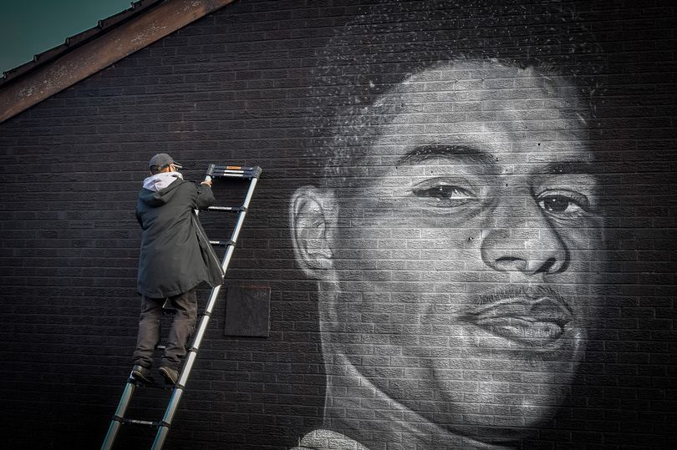
CAMPAIGN THROUGH ART

Slide 11
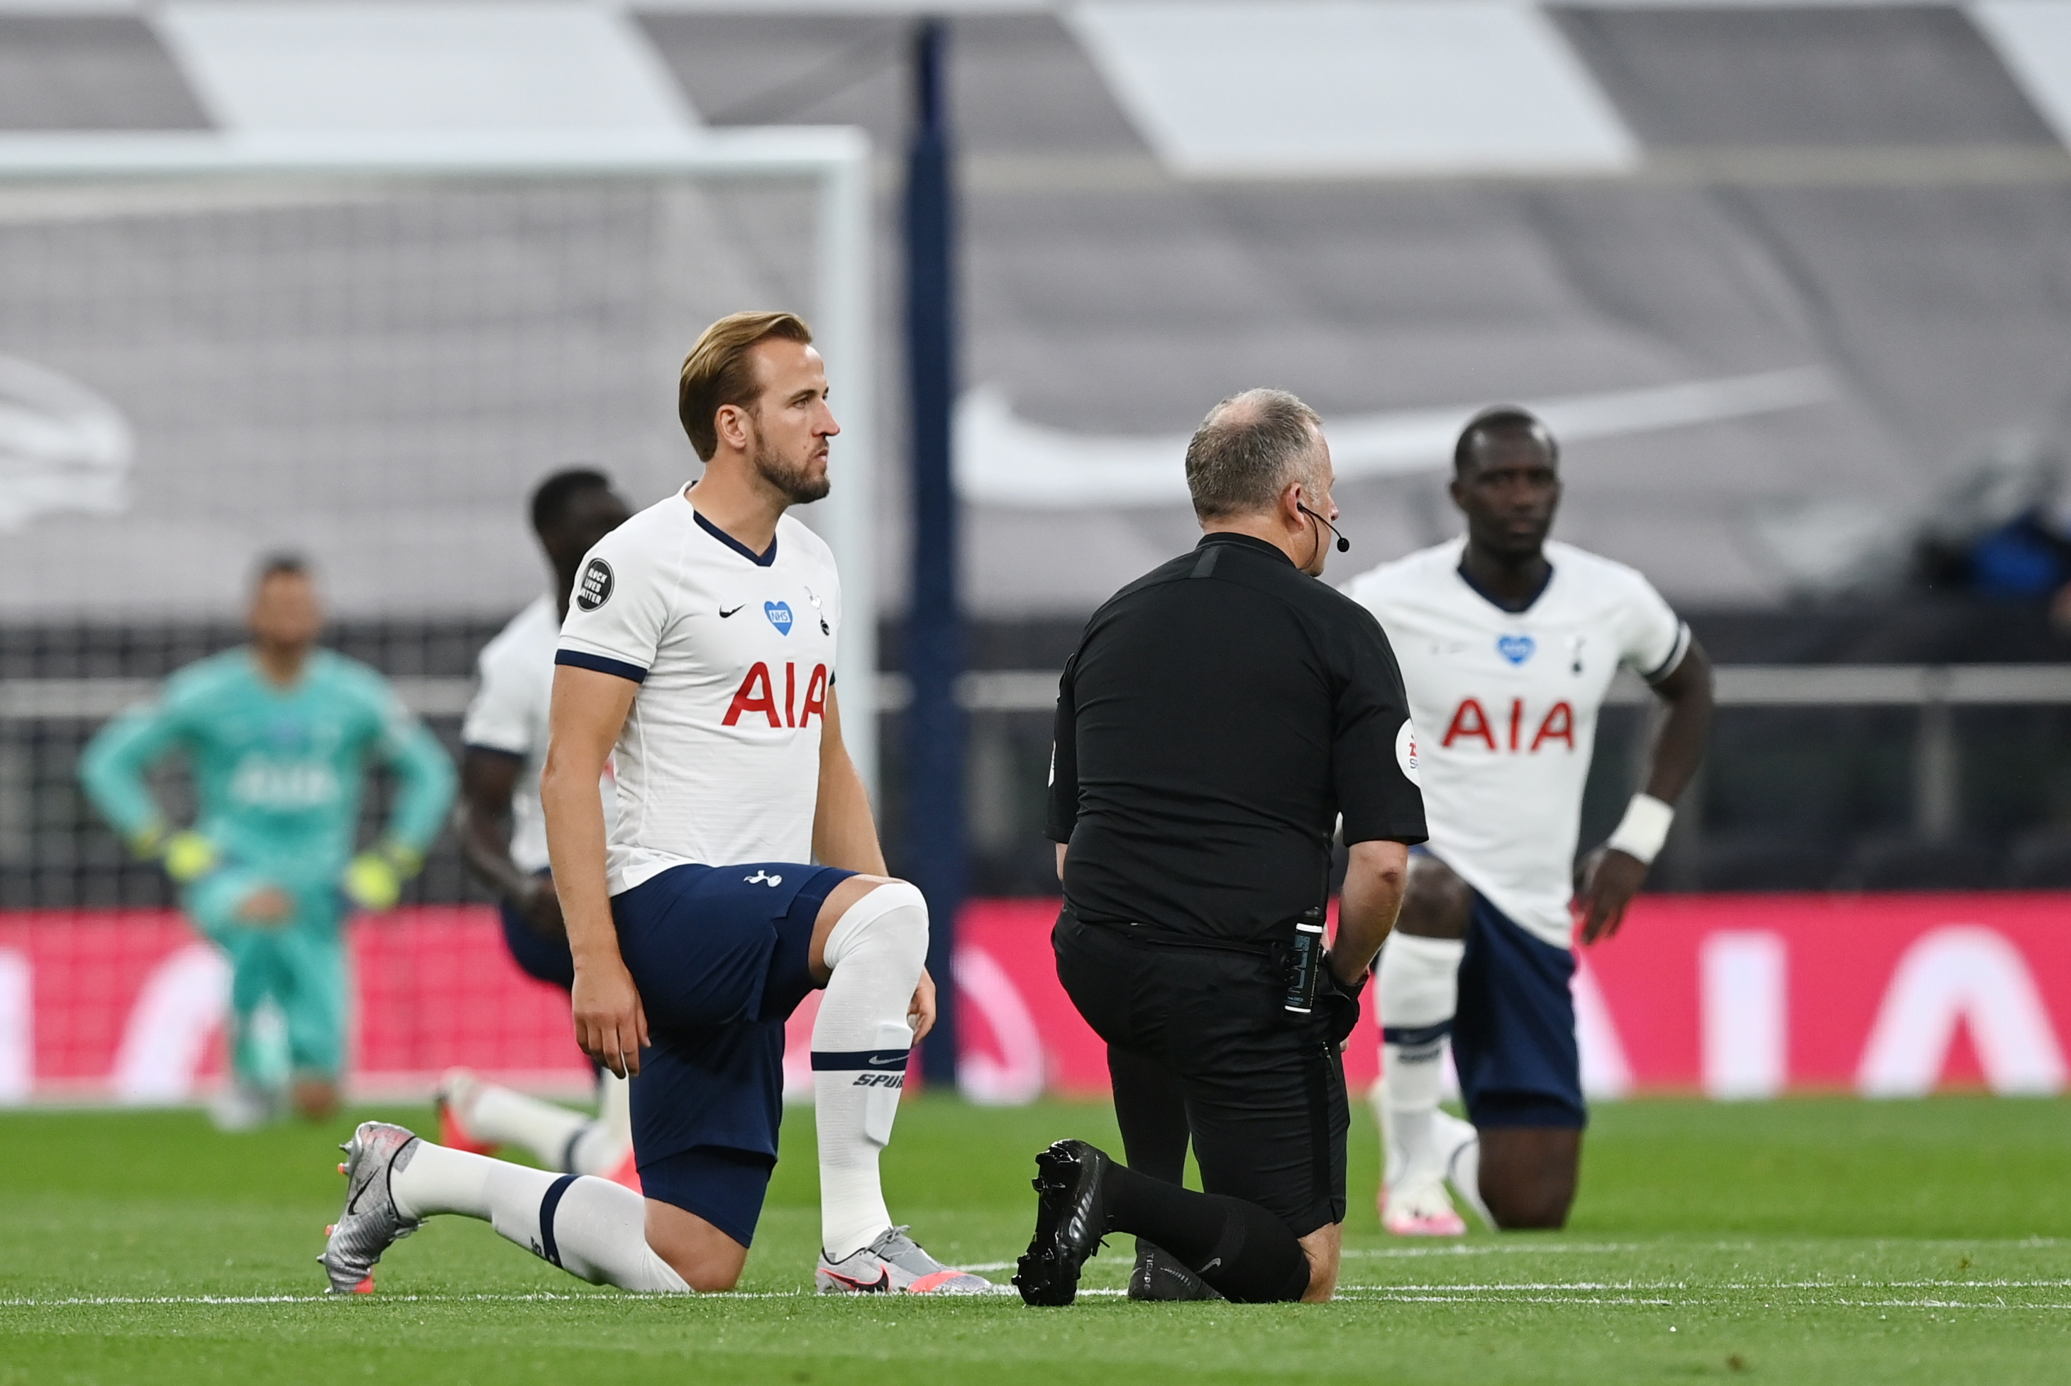
CAMPAIGN THROUGH ACTIONS

Slide 12

START A NEW PROJECT THAT WILL HIGHLIGHT THE ISSUE

Slide 13
HOW CAN YOU MAKE CHANGE?
In pairs discuss which campaign you believe is the most effective and why?

Slide 14
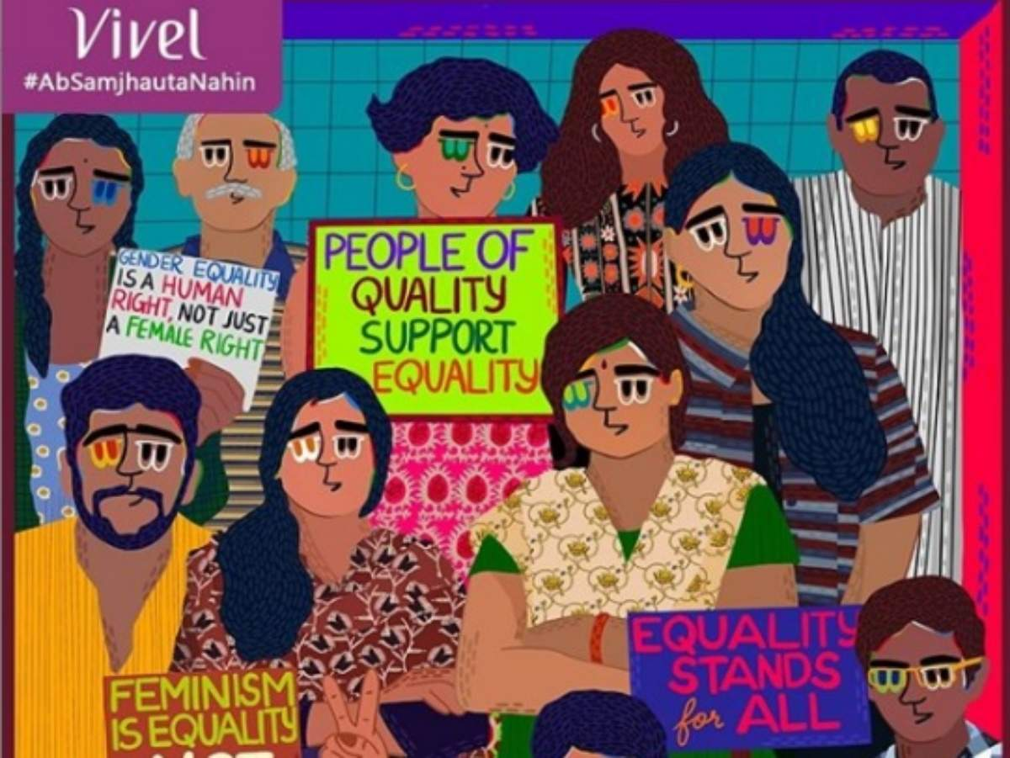
HOW CAN YOU MAKE CHANGE?
Create your ‘GENDER EQUALITY’ campaign artwork

Slide 15


Slide 16
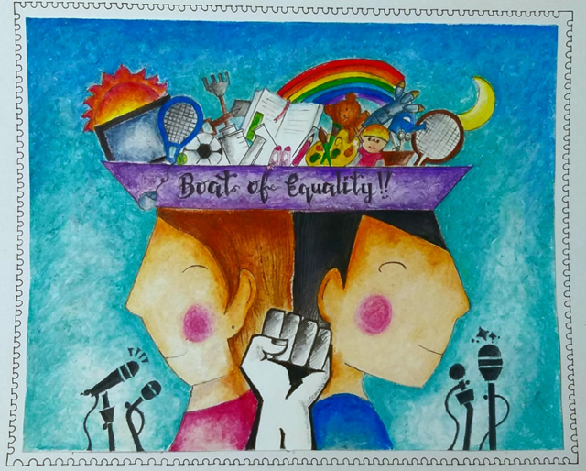
HOW CAN YOU MAKE CHANGE?
In pairs, create a Gender Equality artwork

Slide 17
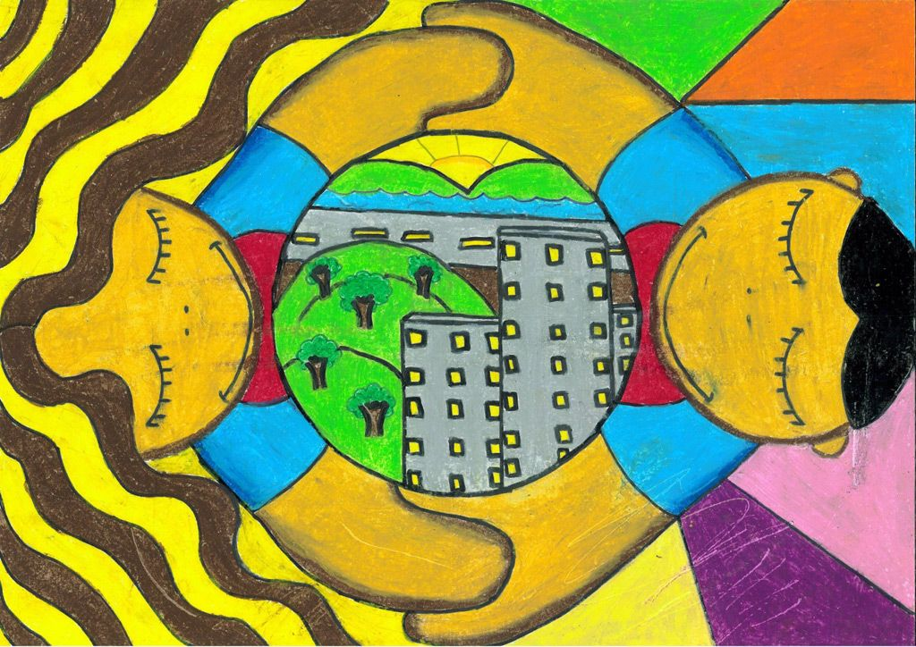
HOW CAN YOU MAKE CHANGE?
In pairs, create a Gender Equality artwork

Slide 18
WHAT DID I LEARN?
What was your favourite part of the lesson and what did you find challenging? Why?
In an ideal world change rarely happens straight away. What can you do to make change happen?
We can sometimes think that the heroes we know about are the only people making changes. Is this true? Why?

