Slide 1

Human Rights and the Digital Environment
RFK HUMAN RIGHTS UK
Changing rights for a changing world?
Speak Truth To Power

Slide 2

Session A
Objectives:
To understand the formation of the International Declaration of Human Rights and how this relates to the United Nations Convention on the Rights of the Child (UNCRC).
To explore the unique rights specific to children and how these are expected to be delivered.
To explore if the rights are relevant to how we live today.

Slide 3

United Nations and the Universal Declaration of Human Rights
As World War II was about to end in 1945, nations were in ruins, and the world wanted peace. Representatives of 50 countries gathered at the United Nations Conference on International Organization in San Francisco, California from 25 April to 26 June 1945. For the next two months, they proceeded to draft and then sign the UN Charter, which created a new international organization, the United Nations, which, it was hoped, would prevent another world war like the one they had just lived through.

Slide 4
The formation of the Universal Declaration of Human Rights
On 12 June 1941 the representatives of five governments including the United Kingdom, and exiled governments of eight countries met in London to state their intention of working together so that, “all may enjoy economic and social security.”
On 14 August 1941, President Roosevelt of the United States and Winston Churchill, Prime Minister of the United Kingdom signed the Atlantic Charter in which they made known “certain common principles in the national policies of their respective countries on which they base their hopes for a better future for the world.”
On 1 January 1942, twenty-six States including the USA, UK, USSR and China subscribed to the principles of working together known as the ‘Declaration by United Nations.’ The term ‘United Nations’ was coined by President Roosevelt.
In 1943, conferences were held in Moscow and Tehran in which the idea of establishing an international organisation to keep the peace after the end of World War 2.
In 1945 a conference was held in Yalta, Crimea where negotiations were held on working together as a global operation.
Notes:
https://cdnapisec.kaltura.com/index.php/extwidget/preview/partner_id/2503451/uiconf_id/43914941/entry_id/1_jxfcupfa/embed/dynamic

Slide 5
Relationship between the United Nations and the Declaration of the Rights of the Child
From 1919 to 1989

Slide 6
United Nations Convention on Rights of a Child
Children’s rights were first championed internationally by a British woman, Eglantyne Jebb.
In 1919 she founded the organisation Save the Children.
She did this in response to seeing children starving because, after World War One, the Allied troops wouldn’t let supplies through to Germany and Austria.
She created flyers and stood in Trafalgar Square in London handing out flyers saying, “Our blockade has caused this – millions of children are starving to death.” She was arrested and fined.
However, the judge was so impressed with her cause he paid the fine. This was the first donation to Save the Children.
In 1924 she attended a conference where she presented the first declaration of the Rights of the Child.
Notes:
Information from Save the Children

Slide 7
Eglantyne Jebb’s first declaration of rights for children in 1924
Every child should be given what they need to grow up happy and healthy.
When a child is hungry, they must be fed. When they are sick, they must be cared for. And when they need support, shelter or guidance, they must be given it.
Whenever there is a crisis, children should be the first to receive aid.
Every child should be protected against exploitation and given the chance to earn a living, when the time comes.
Every child should grow up understanding the importance of using their talents and skills to help others.
Notes:
Information from Save the Children – NB: this has been sanitised and adapted by Save the Children. The original wording is particular to the times:
The child must be given the means requisite for its normal development, both materially and spiritually.
The child that is hungry must be fed, the child that is sick must be nursed, the child that is backward must be helped, the delinquent child must be reclaimed, and the orphan and the waif must be sheltered and succoured.
The child must be the first to receive relief in times of distress.
The child must be put in a position to earn a livelihood, and must be protected against every form of exploitation.
The child must be brought up in the consciousness that its talents must be devoted to the service of its fellow men.

Slide 8
Relationship to United Nations
On 20th November 1959, the United Nations adopted a Declaration of the Rights of the Child, based on the structure and contents of the 1924 original.
In 1979, Poland suggested that there should be a Convention to make sure the rights were held together in a legally binding agreement. This was worked on over the next decade.
On 20th November 1989, the United Nations adopted the Declaration of the Rights of the Child.
20th November is recognised as World Children’s Day.

Slide 9


Slide 10
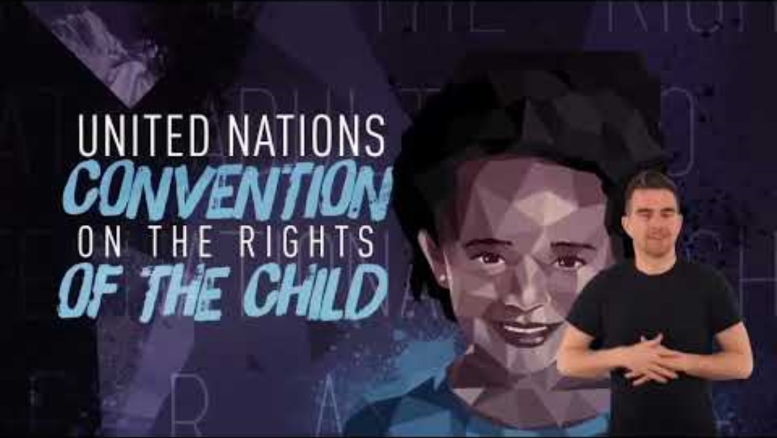

Slide 11


Slide 12
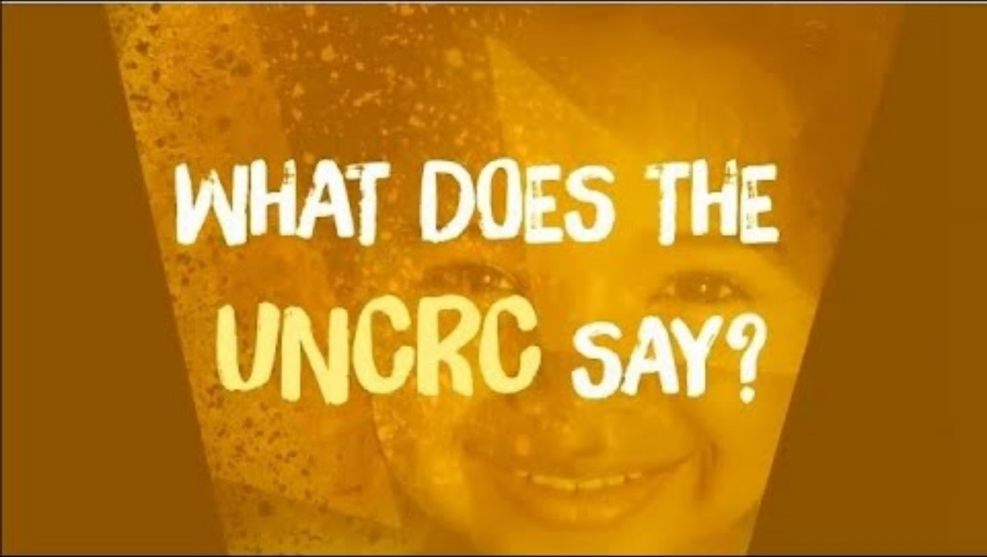

Slide 13


Slide 14
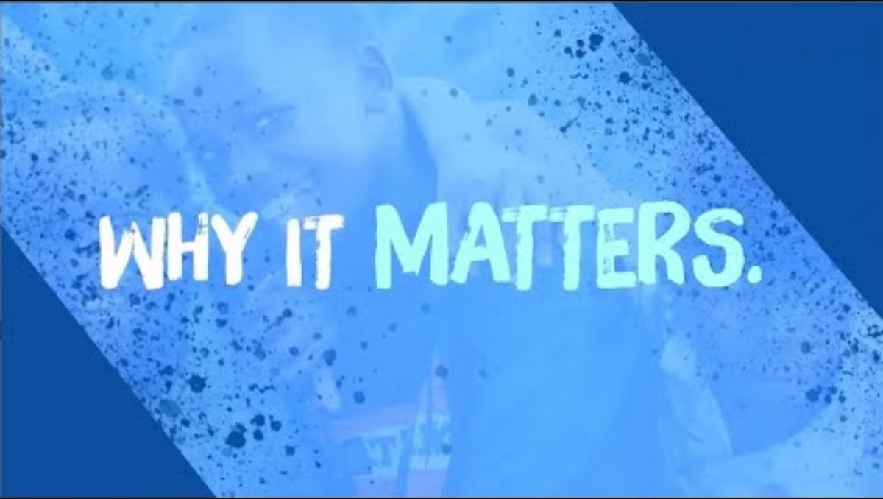

Slide 15
Overarching principles
Non-discrimination (Article 2)
Best interests of the child (Article 3)
Life, survival and development (Article 6)
Children’s views are given full weight (Article 12)
Civil Rights and Freedoms
Family Environment and Alternative Care
Health and Welfare
Education, Leisure and Culture
Special Protection Measures

Slide 16
SESSION B
Understand the benefits of the digital environment and the negative impact on young people.
Explore how developers use persuasive design to encourage us to click on areas that may not be developmentally appropriate.
Explore how are our rights are being met or not met in relation to the digital environment.

Slide 17
Children’s wellbeing in a digital world (Year 3 Index Report 2024)
Children’s digital wellbeing has overall improved in 2023.
The online world can bring about inspiration, creativity and fun.
The online world helps children to be confident and independent.
The online world inspires children to find new hobbies and plan their futures.
Children feel that they are less distant from their friends as they are part of lively social hubs and they feel they are part of a group.
Families feel more engaged in the digital world which support wellbeing.
An increasing number of families are engaged in oversight and dialogue.
More children are talking to their parents if they encounter harmful experiences.
75% of children view technology and the internet as important to their independence.

Slide 18
Children’s wellbeing in a digital world (Year 3 Index Report 2024)
Online use can bring about personal anxiety, social aggression, sleep deprivation and relationships that are based around superficial contact.
12% of children have appearance concerns such as clothing choices and the way they look because of their online activity.
12% of children say spending time online makes them worry about their body shape or size.
7% of children say they feel sad as a direct result of their activities online.
Relatively few teenagers have direct experience of image based harassment and abuse but around half of teenagers have heard about abuse of another young person’s sexual image (i.e. images being shared without consent).
81% of teenagers think sharing nudes is always harmful.
Notes:
Additional information on here from internetmatters.org “Young people’s experiences of online misogyny and image-based abuse.”

Slide 19
PERSUASIVE DESIGN
Who controls what you look at?

Slide 20
What is persuasive design?
Social media was designed by behaviour psychologists to maximise the time you have on screen.
They prime you to look at certain content and then condition you to spend more time on that content.
Research found that with nothing more than hitting the ‘like’ button, social media companies can find out the following:
sexuality (88% accurate for men and 75% for women)
parental relationship status (60% accuracy)
ethnicity (95% accuracy)
political views (85% accuracy)
Further research shows that in just 36 minutes of watch time on TikTok, the company can form a deep understanding of your interest , based only on signals like pausing, rewatching or lingering on a video.

Slide 21
What is persuasive design?
“Persuasive design is a term coined by a psychologist in 2002. It combines the theory of behavioural design with computer technology. Behavioural design uses a system of rewards and punishments to influence human behaviour patterns. Both persuasive and behavioural designs can be used to increase wellbeing for personal and social good. However, it is arguably more often used to manipulate human behaviour so that people subconsciously act in the commercial interests of others.”
Introduction to Disrupted Childhood – The Cost of Persuasive Design commissioned by 5Rights Foundation

Slide 22
“Never before in history have such a small number of designers… had such a large influence on two billion [now three billion] people’s thoughts and choices.”
Tristan Harris, ex-Google Ethicist, founder of the Centre for Humane Technology

Slide 23
“The thought process that went into building these applications, Facebook being the first of them… was all about: ‘How do we consume as much of your time and conscious attention as possible?’ God only knows what it’s doing to our children’s brains.”
Sean Parker, former Facebook president
Notes:
Quotes from Disrupted Childhood
https://5rightsfoundation.com/in-action/disrupted-childhood-the-cost-of-persuasive-design-2023.html

Slide 24
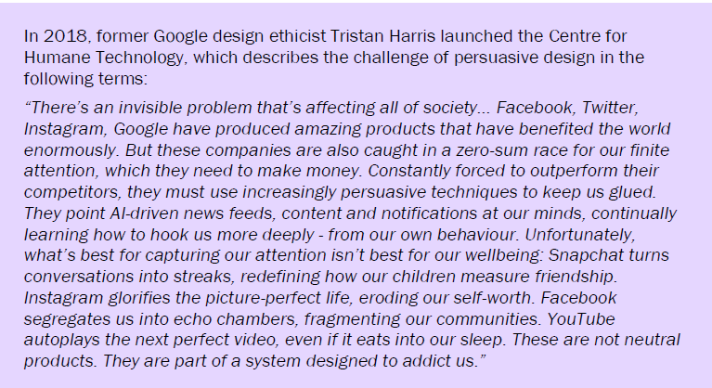
Notes:
Quotes from Disrupted Childhood
https://5rightsfoundation.com/in-action/disrupted-childhood-the-cost-of-persuasive-design-2023.html

Slide 25
PERSUASIVE DESIGN
Should you have more control over what you are able to look at?

Slide 26
Session C
Objectives:
Deliberate who protects us in a variety of situations and what their roles and responsibilities should be.
Explore how their own life is impacted by persuasive design.
Understand how social media companies make money and the business principles around this.

Slide 27
What were the original principles of the internet?
When Tim Berners-Lee first developed the internet, it was meant to be available for everyone, everywhere. He realised that its potential would only every be fully achieved if anyone, anywhere could use it without paying a fee or having to ask to use it.
The principles were fairly revolutionary:
Decentralisation: No permission is needed from a central authority to post anything on the web.
Non-discrimination: That all internet service providers should treat all information equally and not discriminate against the user.
Bottom-up design: That the web should be developed by everyone and not just a small group of experts.
Universality: That all computers must speak the same language.
Consensus: For universal standards to work, everyone had to agree to use them.
Notes:
https://www.britishcouncil.org/anyone-anywhere/history-web

Slide 28
What about children?
The digital environment is a ‘man- and woman-made’ technology and can therefore be designed according to the needs of children
and young people to meet their developmental milestones. So far, however, it has failed to adapt to children’s needs.
Children are often the early adopters of emerging services and technologies and therefore the first to spot its contradictions and
challenges, yet they are rarely asked their opinion, and are very often the last to be heard.
The digital environment looks quite different when we look at it from the point of view of a child’s ability to meet his or
her development goals. Rather than a single environment, it appears as a landscape of opportunity, understanding, risk and
misunderstanding, which is unusually absent of parental advice and regulatory protections.
There is a cavalier attitude towards the needs of young people in the digital environment on their developmental journey. While we focus on, but often fail, to keep children safe, there is little regard for concepts of childhood and graduated maturity, or for the long established societal norms that safeguard the rights and privileges of children.
The digital environment was not intended as a place for childhood, yet more than a third of its nearly 3 billion users are under 18.
Notes:
Digital Childhood: Addressing Childhood Development Milestones in the Digital Environment: Baroness Beeban Kidron, Founder 5Rights and Dr Angharad Rudkin, University of Southampton

Slide 29
Who should protect you?
When you are learning to walk, who should protect you from falling over and hurting yourself?
When you are little, who should protect you from not eating food that may be poisonous or you may have an allergy from?
Who is responsible for keeping you healthy?
If someone is bullying you, who is responsible for protecting you?
If you make a mistake when you are little, who should help you to put it right and move on?
Who should teach you about exercise and diet?
Who is responsible for teaching you the difference between right and wrong?
Who is responsible for protecting you from strangers who want to cause you harm?
Who is responsible for making sure you have rights and are protected?
Who is responsible for keeping you safe?
Who is responsible for making sure you have a right to privacy?
Who is responsible for making sure you are given accurate information?
Who shares responsibility for your wellbeing?

Slide 30
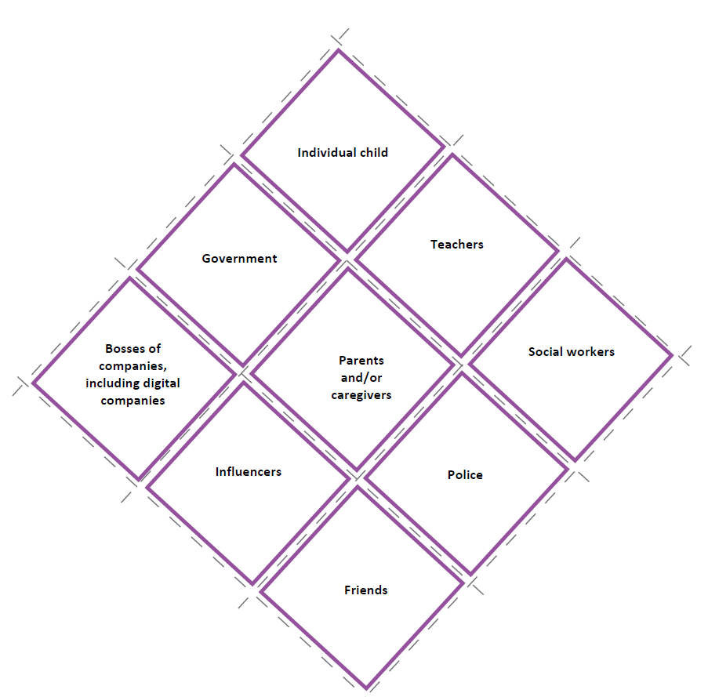

Slide 31
Who should protect you?
Who is responsible for keeping you healthy online?
If someone is bullying you, who is responsible for protecting you online?
If you make a mistake when you are online, who should help you to have it forgotten?
Who should teach you about exercise and diet online?
Who is responsible for teaching you the difference between right and wrong online?
Who is responsible for protecting you from strangers who want to cause you harm online?
Who is responsible for making sure you have rights and are protected online?
Who is responsible for keeping you safe online?
Who is responsible for making sure you have a right to privacy online?
Who is responsible for making sure you are given accurate information online?
Who shares responsibility for your wellbeing online?

Slide 32
Our brain works fast….
We make shortcuts for making decisions from the way we process information to the way we relate to others around us. For example:
We pay more attention to fearful, dangerous stimuli to stay safe.
We seek out sweet and fatty foods for their readily available energy.
We remember things that hurt us more than things that help us so we can predict future consequences.
We tend to follow the popular opinion of those around us to build stronger communities around shared ideas.
Persuasive design knows this and is honed to tap into our psychology and push us towards certain behaviours:
Notifications (like vibrations, buzzing, red dots, flashing lights, etc.) mimic naturally occurring signs of danger to pull us into apps.
The possibility of new comments or "likes" keeps us compulsively monitoring for updates, seeking feelings of pleasure and reward.
Design features like infinite scroll (where when you reach the bottom of the page and more content loads automatically) keep us continuously engaged.
Notes:
From the Center for Humane Technology

Slide 33
Why?
Social media isn’t free, we pay for it with our data.
Our data informs advertisers who want to sell us goods. This makes the social media company more money.
The commercial goals for social media are to: increase the number of users; maximise the amount of time users spend on the service; increase the amount of content generation and interaction with the service.
When we click, and the evidence suggests that the more likely it is to make us angry or be shocking it generates more content, they get more money.
We engage with content that makes us angry or laugh
The social media companies get more data on what we are like
This goes to the advertisers and they can target us more
The social media companies make more money
Notes:
Diagrams from Disrupted Childhood

Slide 34
Examples
Many game apps use loot boxes. Loot boxes are mystery clicks (often costing real money) that yield random virtual rewards. They operate much like scratch lottery tickets and can easily become addicting.
Google Search uses a sophisticated algorithm to find the best matches for what you’re looking for. But what’s above those “best matches”? Paid ads, that look like search results, where advertisers compete to pull you away!
On Google Maps, advertisers can pay for their location to be a “promoted pin” on the map. So now, instead of simply offering users directions, Google Maps offers advertisers the ability to compete for your attention while you’re using the app for another purpose. They use factors like search/browsing history, interests, time of day, and demographics to choose what ads to show.

Slide 35
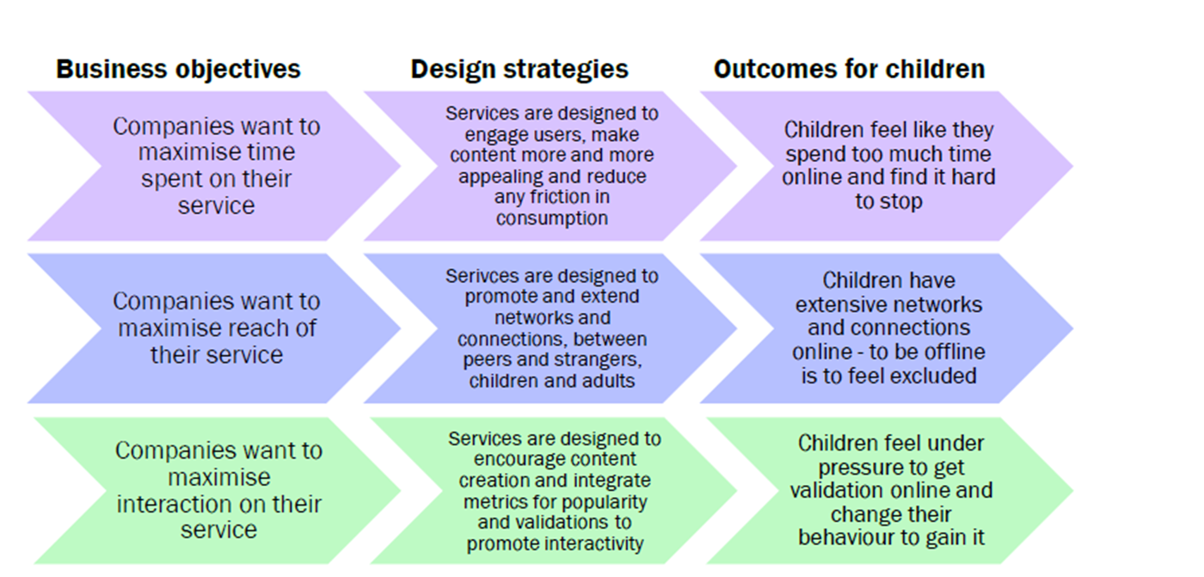
What is the impact?

Slide 36


Slide 37
Session D
Objectives:
For students to understand the impact of social media on individual people and on mental health and anxiety.
To identify where our rights as children are not being met in the digital world.
To be able to articulate why they think they are not being met in a formal presentation.

Slide 38
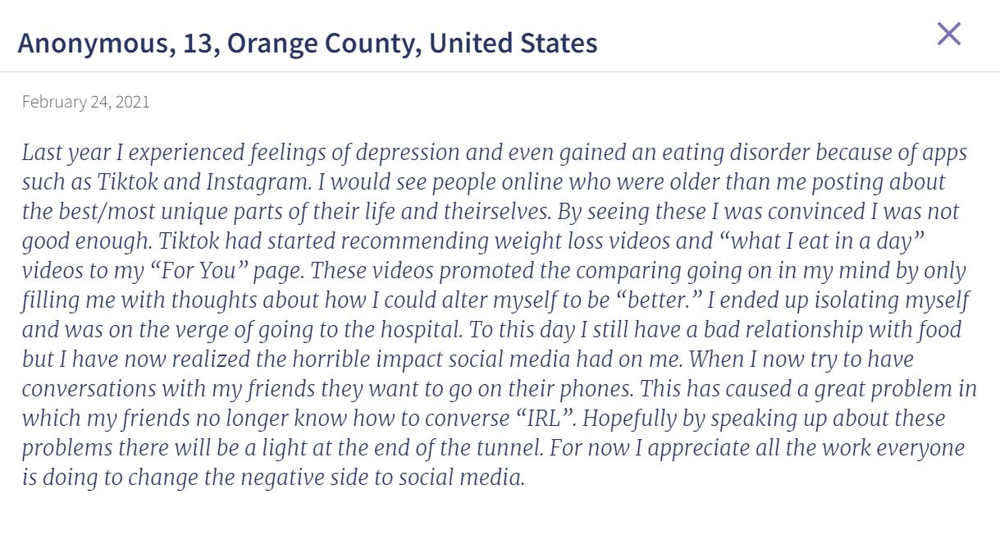

Slide 39
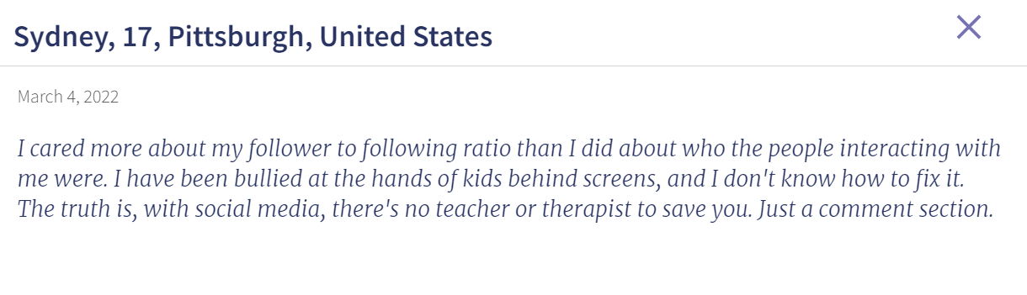

Slide 40
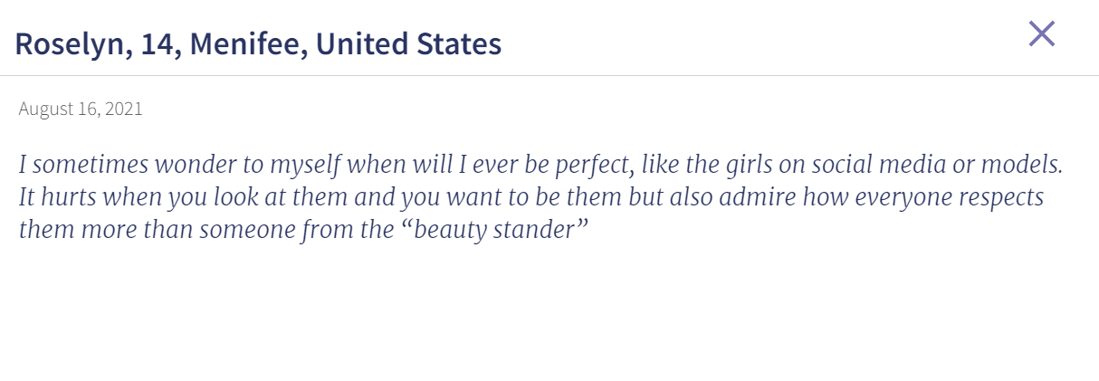

Slide 41
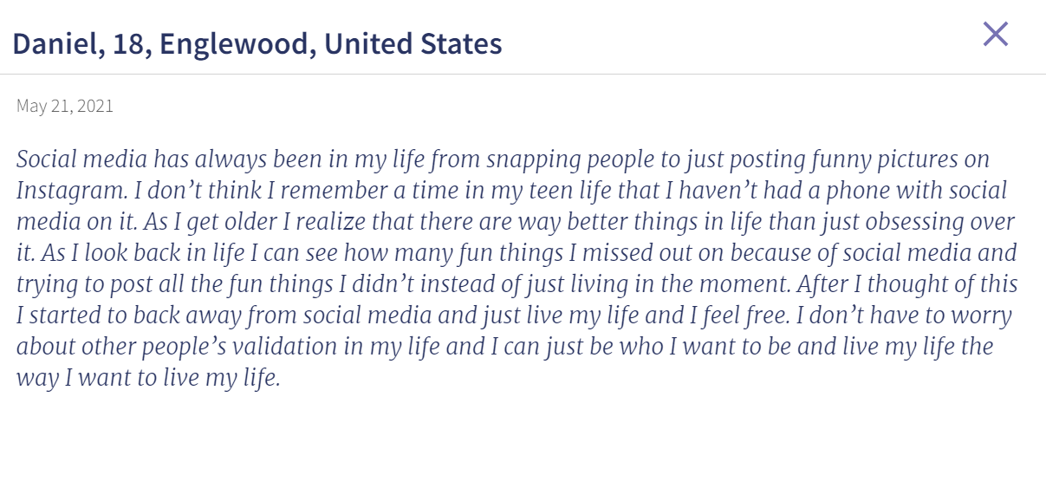

Slide 42
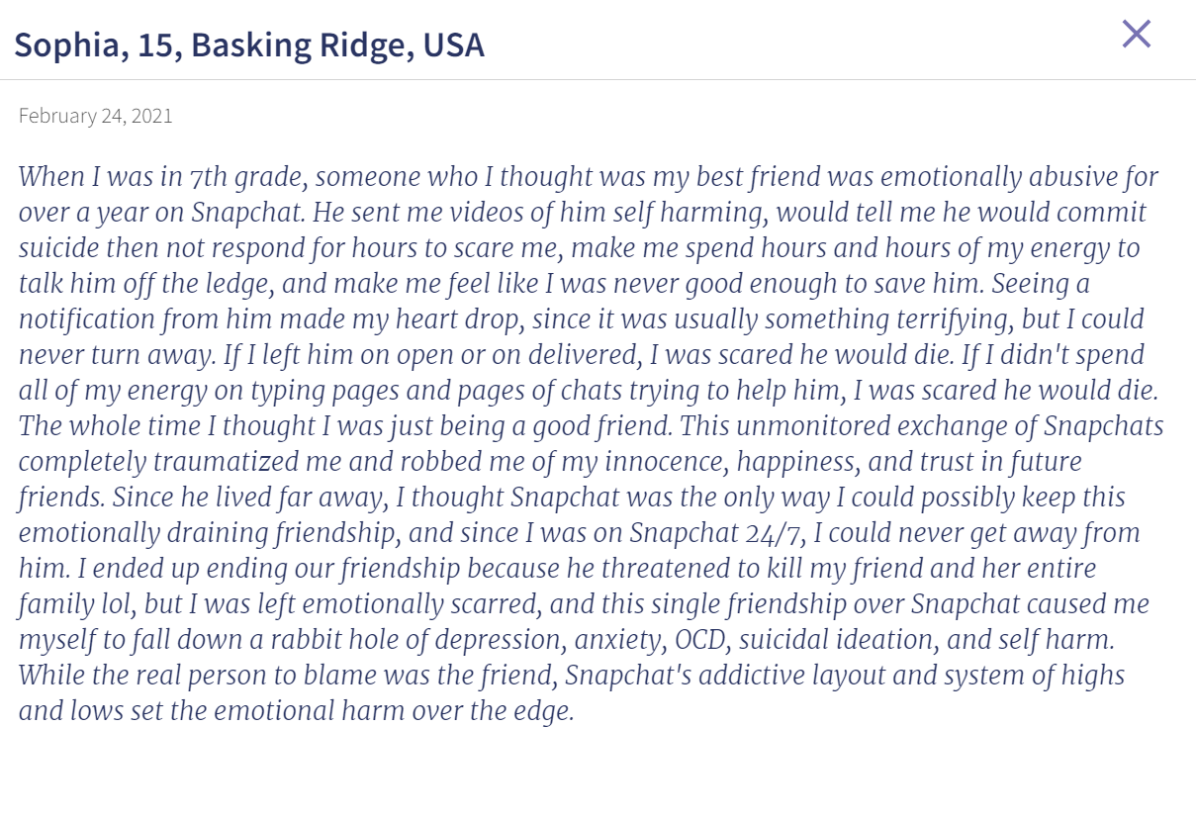

Slide 43
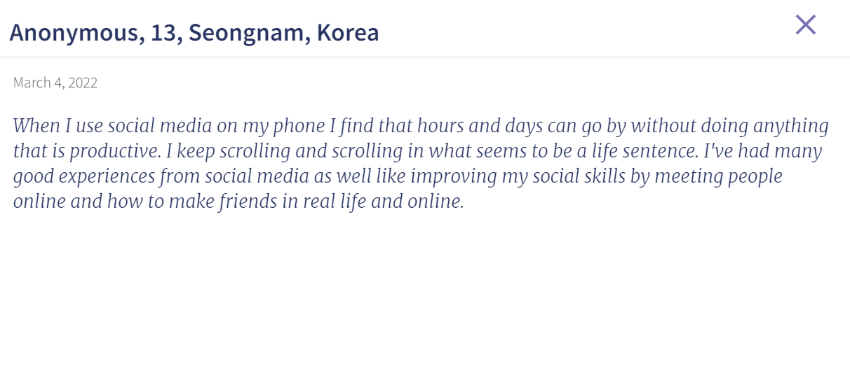

Slide 44
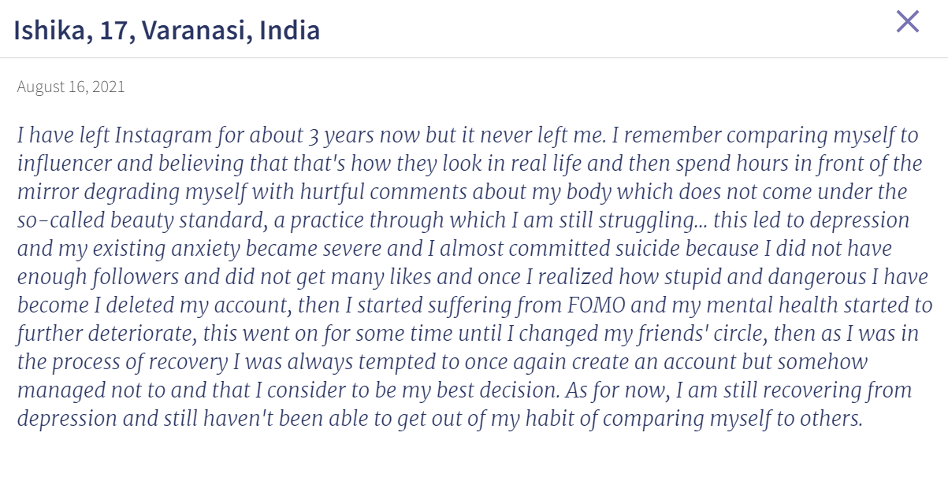

Slide 45
The negative impact
We pay more attention to fearful, dangerous stimuli to stay safe.
We remember things that hurt us more than things that help us so we can predict future consequences.
We tend to follow the popular opinion of those around us to build stronger communities around shared ideas.
But these shortcuts don’t work perfectly in every situation. They can become cognitive biases, or ways in which our brains’ patterns make us vulnerable to errors in judgment, manipulation, and exploitation.
Some people’s behaviour can be manipulated by their social environment.
Technology can have immense power over what we say we believe.

Slide 46
What happens online matters everywhere…
Our attention gets diverted to what is pulling us in.
We are always looking for new possibilities.
We engage with negative content more than positive content. Social media that generates fear, anger or disgust sees higher engagement and spreads more quickly than positive content. Algorithms make this worse.
We compare ourselves to others.
We become isolated in bubbles only listening or watching to those that don’t socially exclude us.
Why is this so much more important for young people?

Slide 47
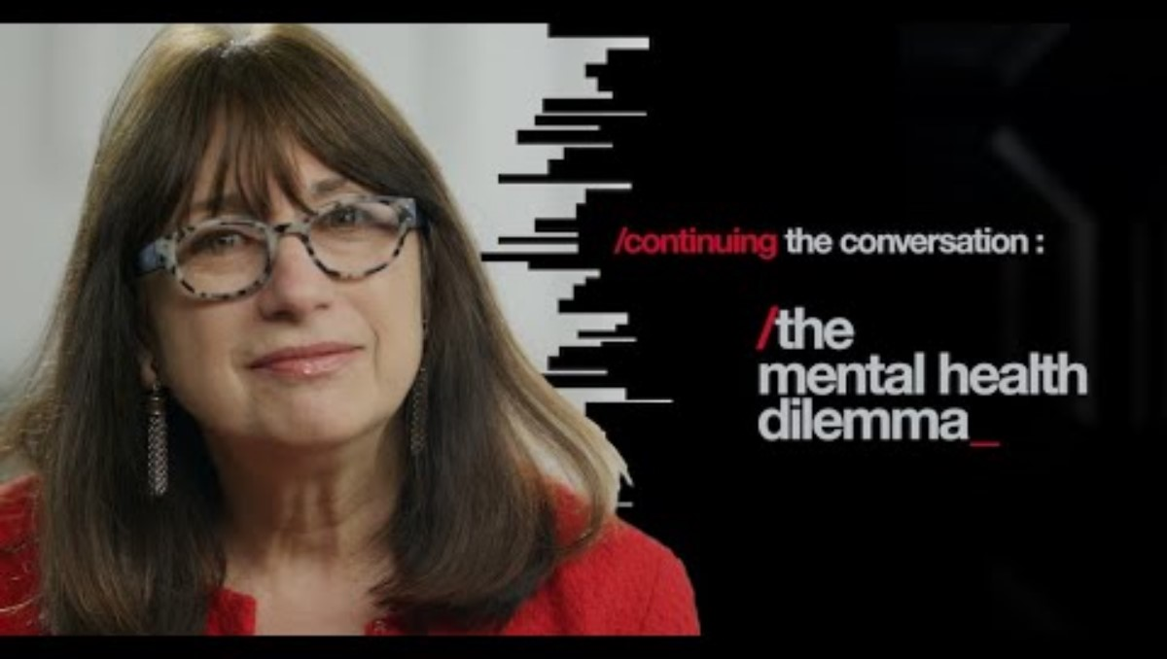

Slide 48


Slide 49
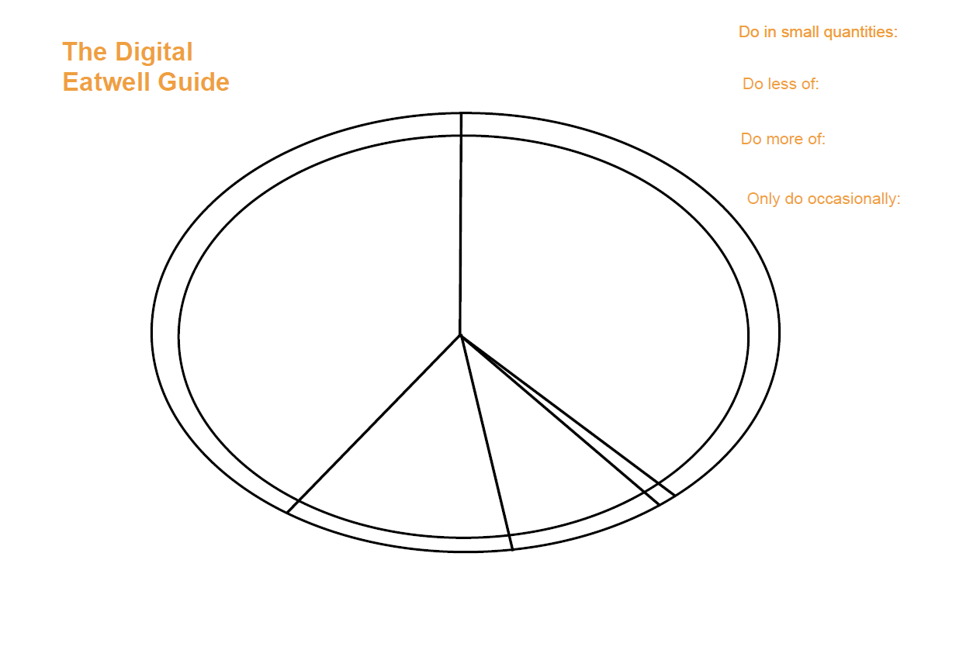

Slide 50
Set boundaries
Reduce their intrusion into your life:
1. Turn off notifications and badges.
2. Set your device to grayscale to make it less visually stimulating and attractive.
Reduce harmful APPS by:
1. Hiding them from your home screen
2. Unfollow accounts that are negatively impacting your health.
Eliminate those that make you angry by:
1. Unfollow rage bait voices
2. Follos positive news sources instead.

Slide 51
Session E
Objectives:
For students to understand the impact of social media on individual people and on mental health and anxiety.
To identify where our rights as children are not being met in the digital world.
To be able to articulate why they think they are not being met in a formal presentation.

Slide 52
Children’s Parliament Scotland
The Children’s Parliament in Scotland makes sure that the UNCRC is embedded in every piece of legislation that is passed.
In relation to digital rights there are five areas that they have focused on:
Right to Remove – this allows children to ask for anything they have posted online to be deleted.
Right to Know – this allows children to know who holds their data and might make money from any information they have given online.
Right to Safety and Support – this helps children to know who to go to if they need help, and to be protected from anything illegal.
Right to informed and conscious use – this helps children control how they use technology and how often they use it.
Right to digital literacy – this allows children to have the chance to learn how to use technology effectively.
Notes:
https://www.childrensparliament.org.uk/

Slide 53
United Nations General Comment No. 25
In 2021, the United Nations provided a general comment that the rights of every child must be respected, protected and fulfilled in the digital environment. This was the result of a two year consultation.
It says all children should have equal and effective access to the digital environment.
That states should make sure that children are a primary consideration in the provision, design and management of the digital environment.
That risks posed by the digital environment to children’s safety should be addressed.
That children’s views should be considered.
This follows the four principles outlined in an earlier session. Can you remember what the four guiding principles are?

Slide 54
In 2024, the UK passed the Online Safety Bill. For children this means:
For social media services, gaming services, discussion forums providers should identify risks to children and take appropriate steps to protect them from some types of harmful content.
When children are searching there needs to be steps in place that identify risks and take appropriate steps to protect them from types of harmful content.
Video sharing platforms should make sure harmful content is not available for children.
That children should not be able to access pornographic images.
If providers do not do this, they can be fined.
By notifying Ofcom, we can raise complaints.

Slide 55
Is this enough?
Is it working?
What more can we do?

Slide 56

Notes:
https://5rightsfoundation.com/

Slide 57

Notes:
https://5rightsfoundation.com/

Slide 58

Notes:
https://5rightsfoundation.com/

Slide 59

Notes:
https://5rightsfoundation.com/

