Slide 1

Year 2 – Climate Change
RFK HUMAN RIGHTS UK
Session 6
Speak Truth To Power

Slide 2


SESSION 6:
Based on Article 24 of the UN Convention of the Rights of a Child; Every child has the right to the best possible health. Governments must provide good quality healthcare, clean water, nutritious food and a clean environment.

Slide 3
You will learn how to express your thoughts and idea through Music and Song

Slide 4
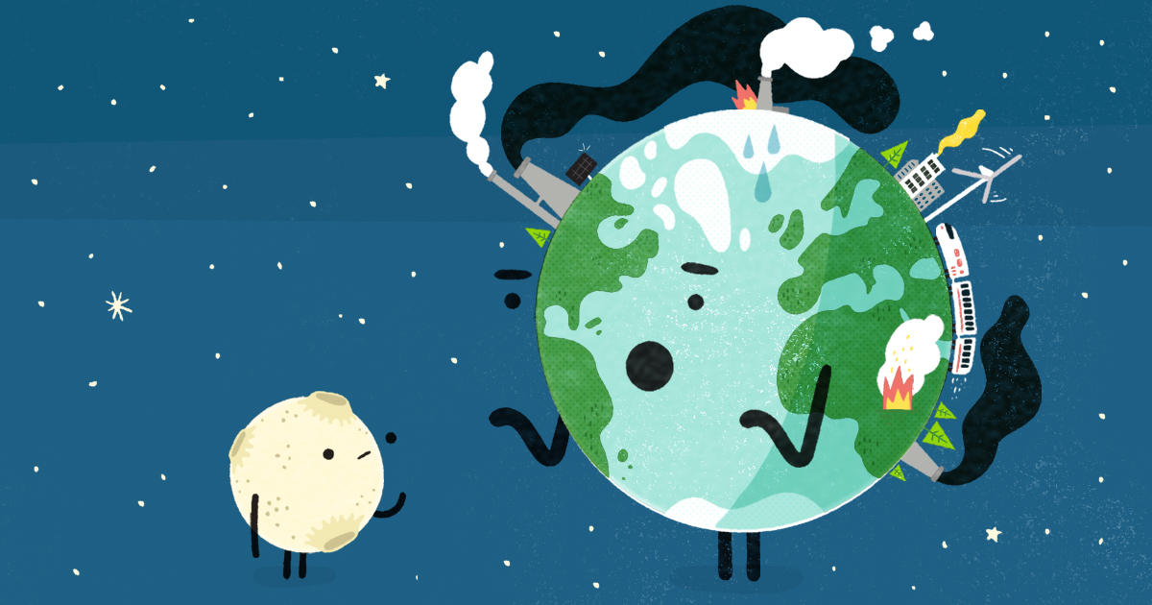
MUSIC & SONG
In pairs, create a verse of a Human Rights song.
Each verse should have four lines.
Perform and record the verse.

Slide 5
You will learn how to express your thoughts and idea through Music and Song

Slide 6


