Slide 1

Year 6 – LGBTQ+
RFK HUMAN RIGHTS UK
Session 2
Speak Truth To Power

Slide 2


SESSION 2:
Based on Article 12 of the UN Convention of the Rights of a Child; Every child has the right to express their views, feelings and wishes in all matters affecting them, and to have their views considered and taken seriously. This right applies at all times.

Slide 3
Who and what make Movements for Change happen?

Slide 4
CHANGEMAKERS

Slide 5
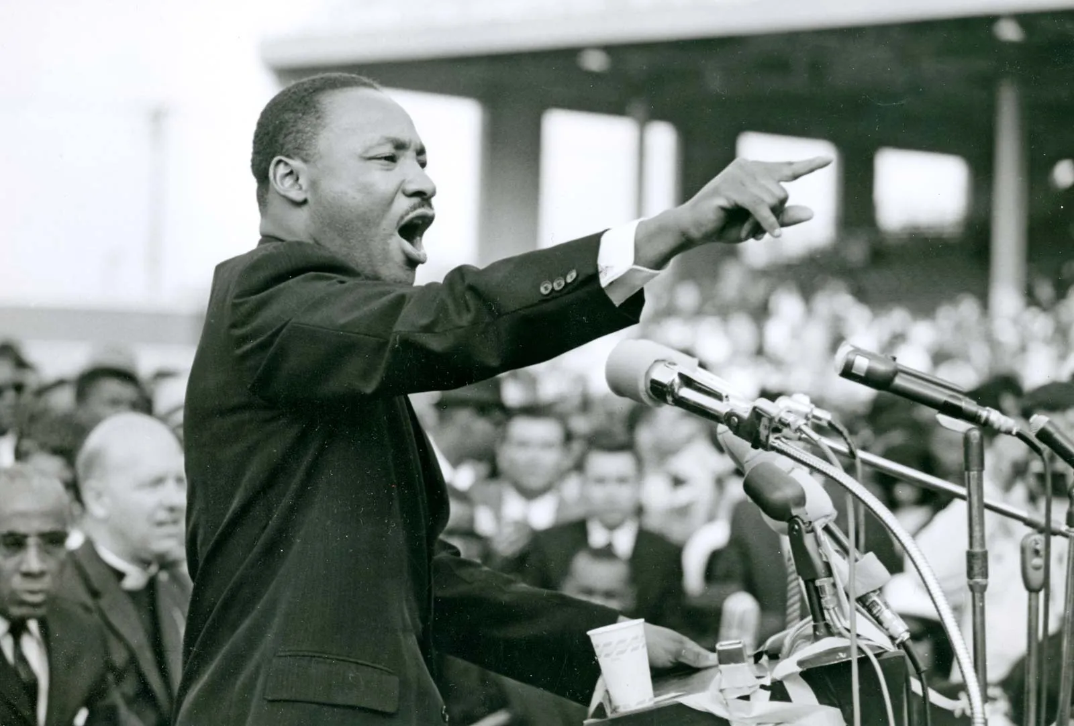
Who Am I? How Did I Make a Difference?

Slide 6
Martin Luther King – Human Rights Activist, Campaigner for Equality

Slide 7
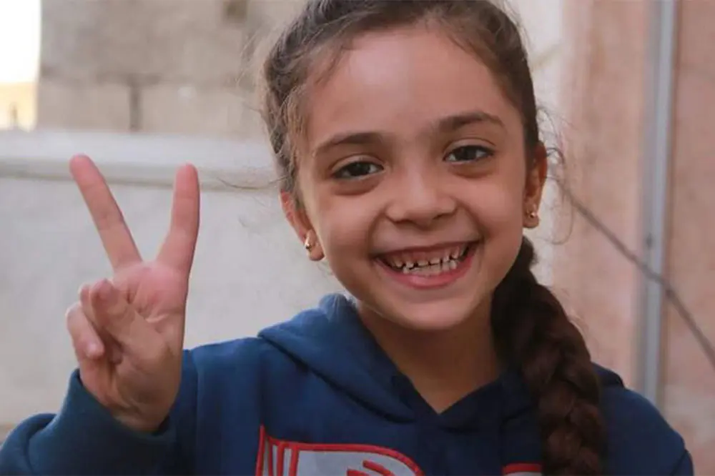
Who Am I? How Did I Make a Difference?

Slide 8
Bana Al Abed – Human Rights Activist, Campaigner for Peace

Slide 9
Watch this video https://www.youtube.com/watch?v=BY12wgAiqp4

Slide 10
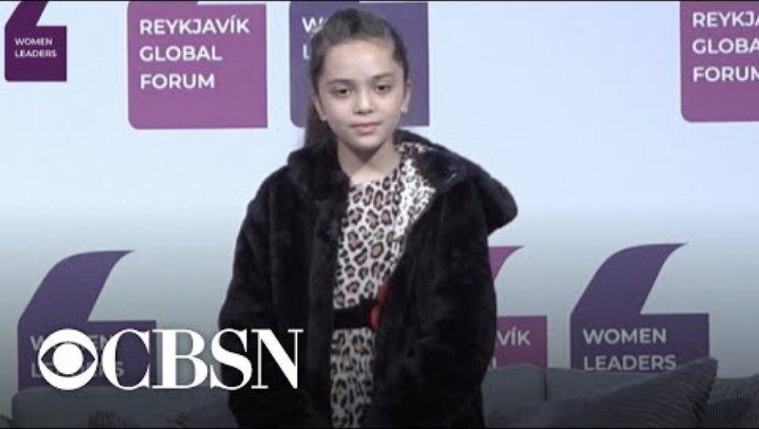
Watch this video https://www.youtube.com/watch?v=BY12wgAiqp4

Slide 11
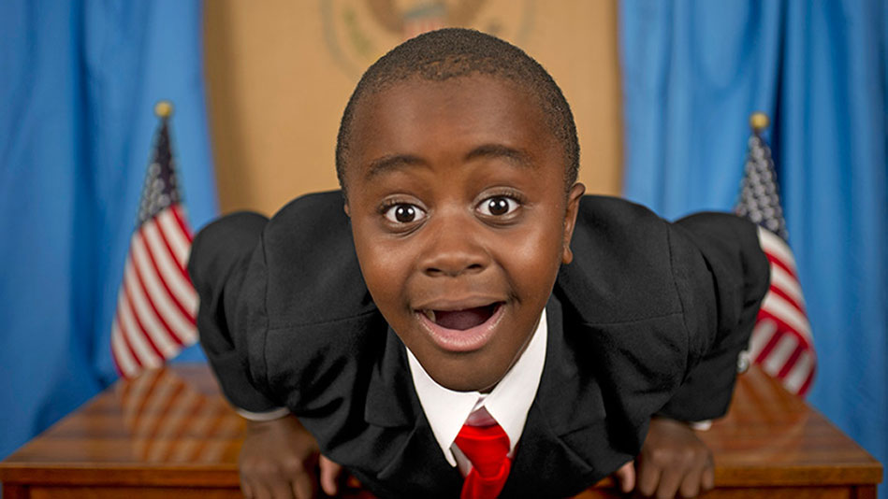
Who Am I? What Skills Do I Have?

Slide 12
Robby Novak – Campaigner for Children’s Rights and Equality

Slide 13
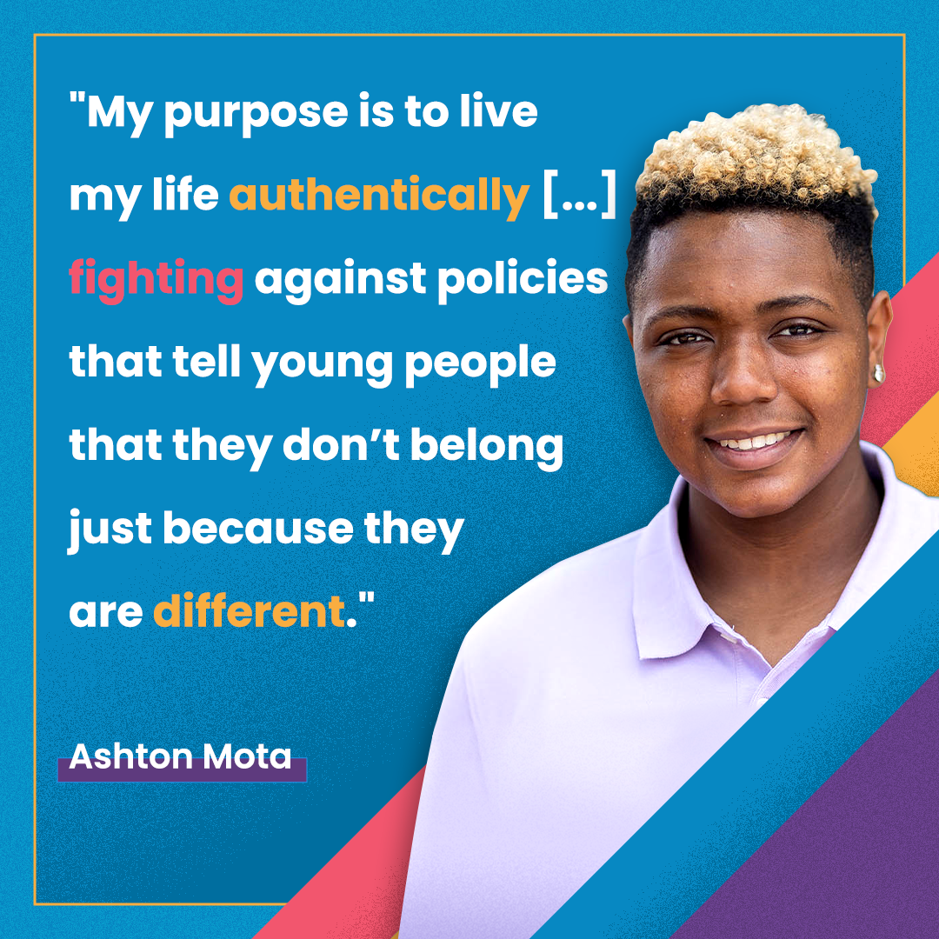
Ashton Mota – Activist for Equality
Watch this Video:
https://www.youtube.com/watch?v=rsBzbZbLQgg

Slide 14
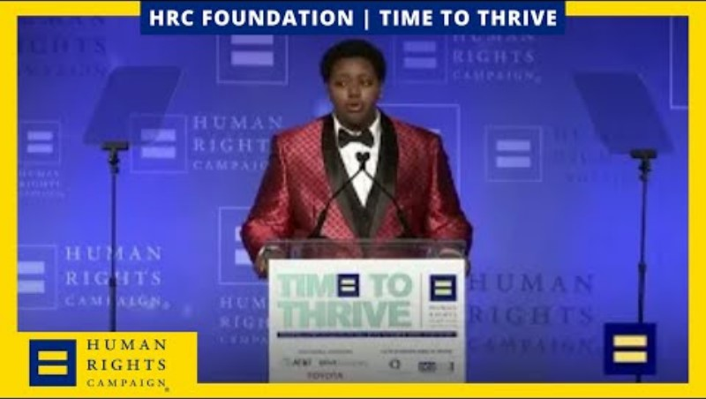
Watch this video

Slide 15
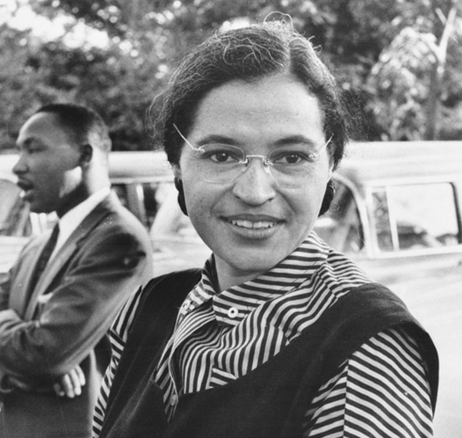
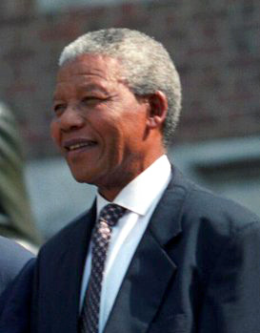
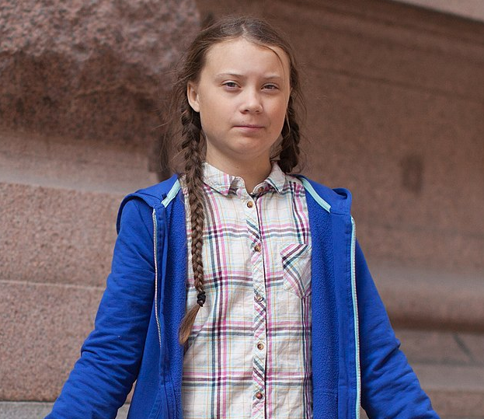
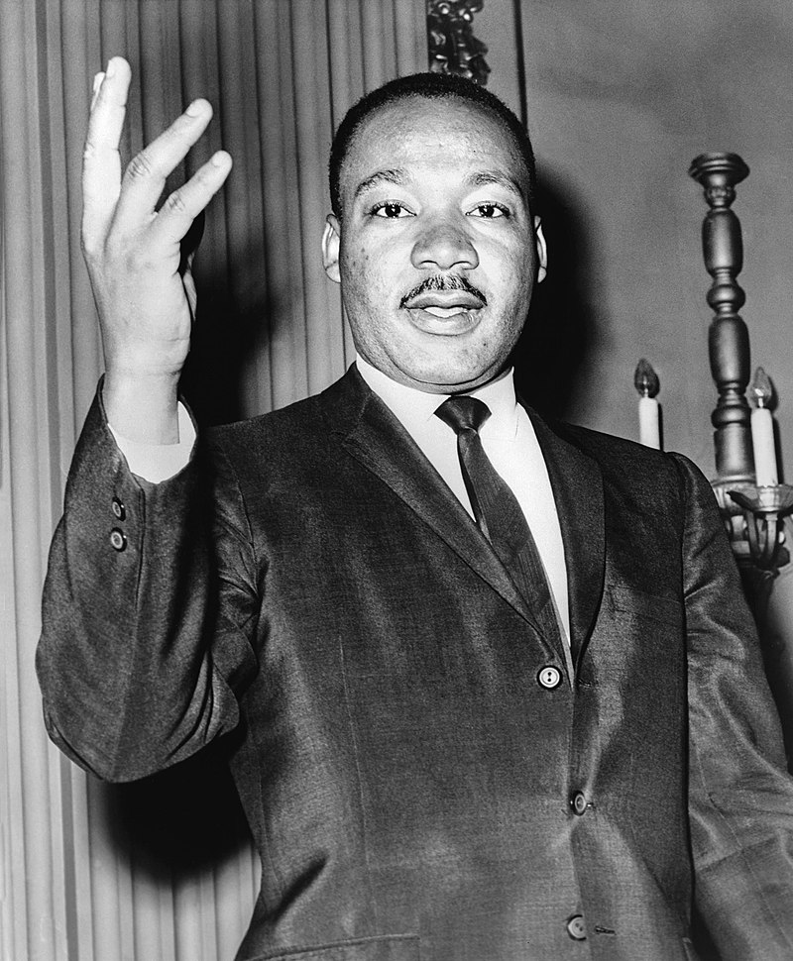
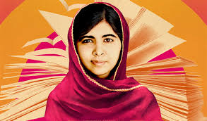
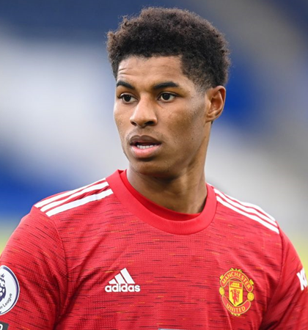
Who are these human rights activists?
Notes:
https://www.theguardian.com/politics/2010/dec/28/jayaben-desai-obituary

Slide 16
What do/did they do?
Notes:
https://www.theguardian.com/politics/2010/dec/28/jayaben-desai-obituary

Slide 17
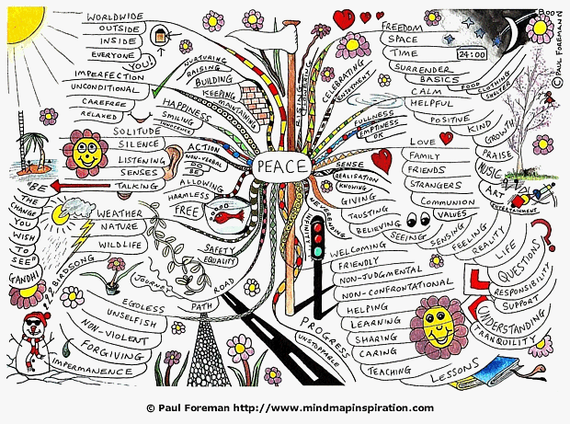
Create your Human Rights Creative Mindmap

Slide 18
What Did You Learn?

