Slide 1

Year 4 – Gender Equality
RFK HUMAN RIGHTS UK
Session 2
Speak Truth To Power

Slide 2


SESSION 2:
Based on Article 4 of the UN Convention of the Rights of a Child; Governments must do all they can to make sure every child can enjoy their rights by creating systems and passing laws that promote and protect children’s rights.
What does this mean to you? Discuss with your partner.

Slide 3
Who and what make Movements for Change happen?

Slide 4
CHANGEMAKERS

Slide 5
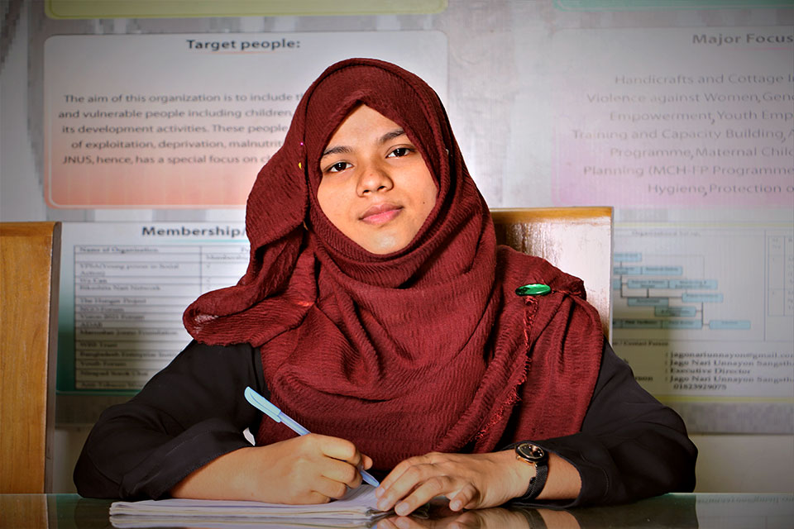
Who Am I? How Did I Make a Difference?

Slide 6
Rima Sultana Rumu, Human Rights Activist for Women’s Rights

Slide 7
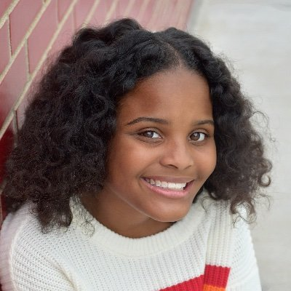
Who Am I? How Did I Make a Difference?

Slide 8
Mari Copeny, Human Rights Activist & Campaigner for Women’s Rights Climate Change Education

Slide 9
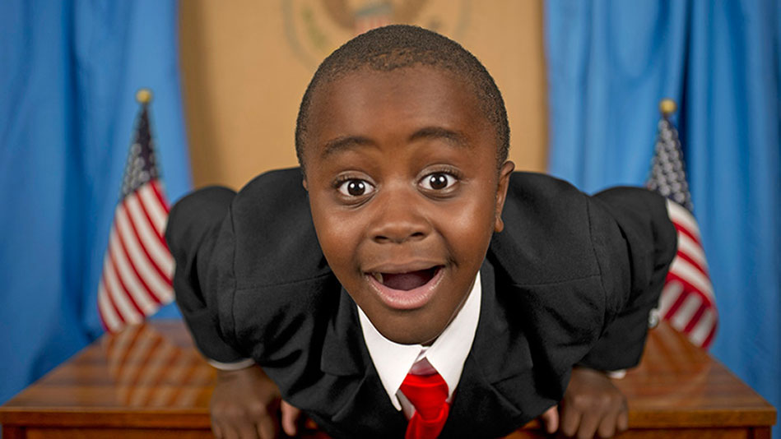
Who Am I? How Did I Make a Difference?

Slide 10
Robby Novak – Campaigner for Children’s Rights Equality

Slide 11
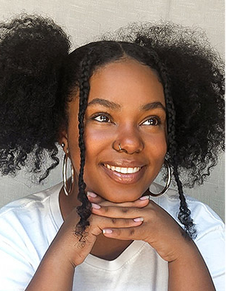
Malala Yousafzai – Activist for Women’s Rights
Watch this Video:
https://www.youtube.com/watch?v=jMxjjV8P52w

Slide 12
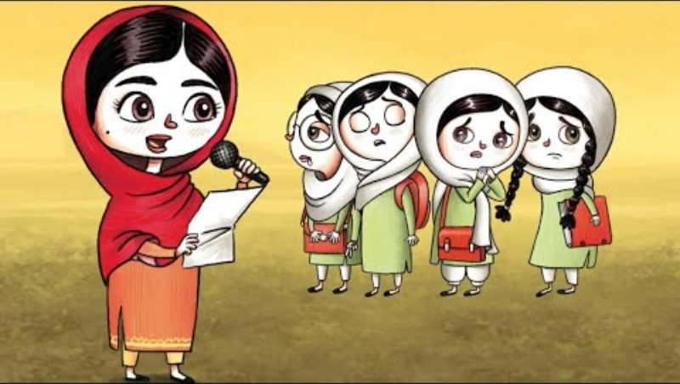
Watch this video

Slide 13
What kind of skills and qualities did these Human Rights heroes have?
Discuss

Slide 14
What did the Human Rights heroes do to create the movement they were involved in?
Discuss.

Slide 15
Do Human Rights heroes make change on their own?
Discuss.

Slide 16
What kind of people do we need to make Change?
Discuss.

Slide 17

Create your Human Rights Creative Mind map

Slide 18
What Did You Learn?

