Slide 1

Year 1 – Friends
RFK HUMAN RIGHTS UK
Session 2
Speak Truth To Power

Slide 2


SESSION 2:
Based on Article 15 of the UN Convention of the Rights of a Child; Every child has the right to meet with other children and to join groups and organisations
What does this mean to you? Discuss with your partner.

Slide 3
Who and what make Movements for Change happen?

Slide 4
CHANGEMAKERS

Slide 5
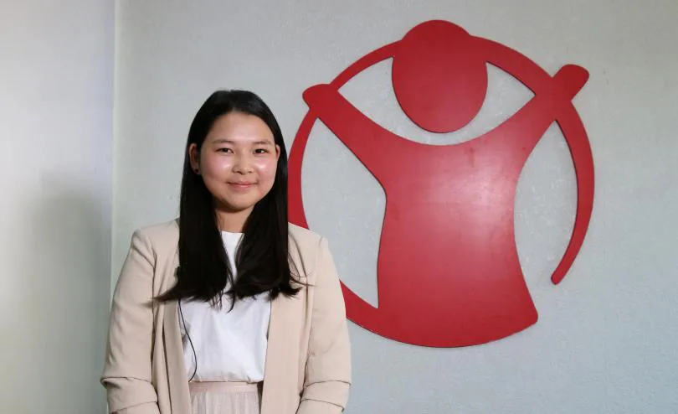
Who Am I? How Did I Make a Difference?

Slide 6
Miga, Human Rights Activist for Children’s Rights

Slide 7
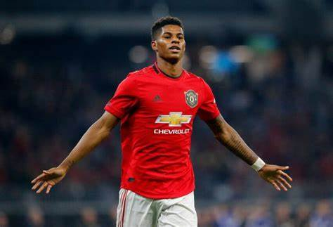
Who Am I? How Did I Make a Difference?

Slide 8
Marcus Rashford, Human Rights Activist, Campaign for Reading, Campaign for Free School Meals Movement

Slide 9
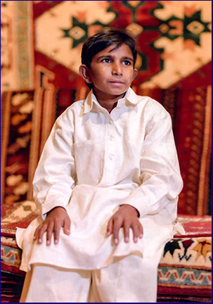
Who Am I? How Did I Make a Difference?

Slide 10
Iqbal Masih, Campaigner for Children’s Rights

Slide 11
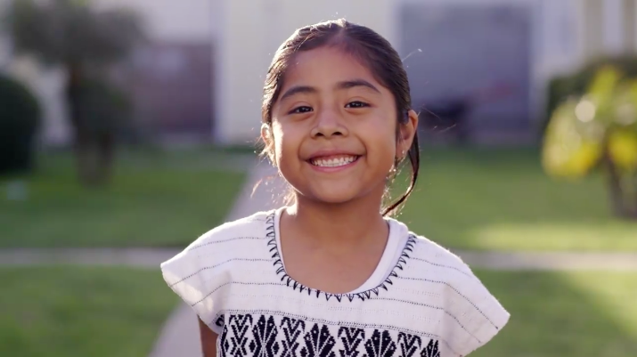
Sophie Cruz, Activist for Children’s Rights
Watch this Video: https://www.youtube.com/watch?v=V7RIkeCgcz0S

Slide 12
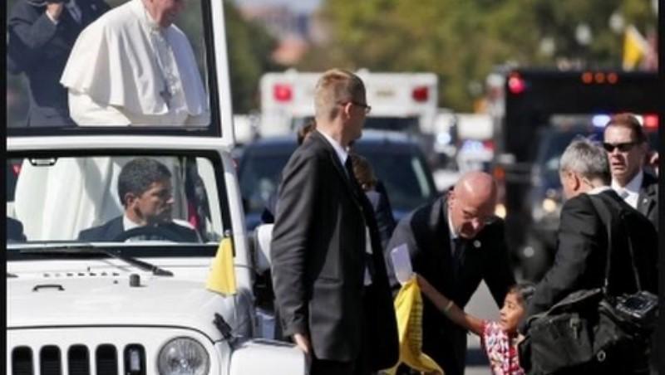
Watch this video

Slide 13
What kind of skills and qualities did these Human Rights heroes have?
Discuss

Slide 14
What did the Human Rights heroes do to create the movement they were involved in?
Discuss.

Slide 15
Do Human Rights heroes make change on their own?
Discuss.

Slide 16
What kind of people do we need to make Change?
Discuss.

Slide 17
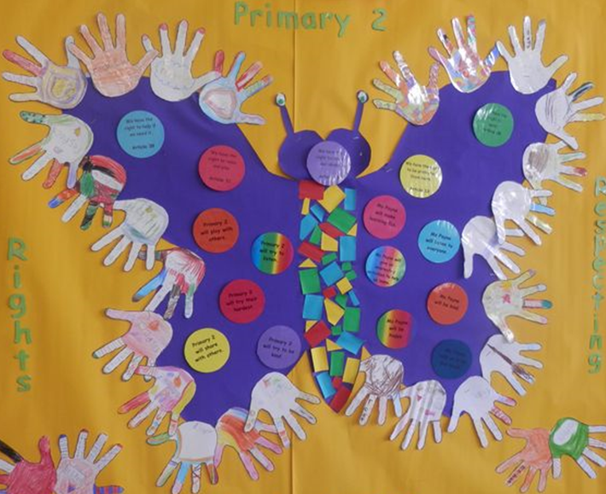
Create your Human Rights Hands

Slide 18
What Did You Learn?

