Slide 1

Movements That Made a Difference
RFK HUMAN RIGHTS UK
Key Events in UK History
Speak Truth To Power

Slide 2
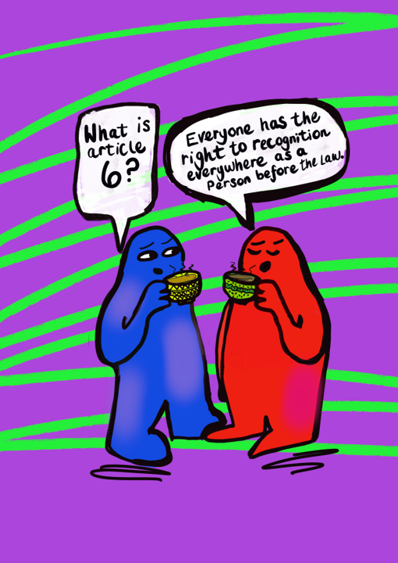

SESSION A:
Article 1
Article 6
Article 24
Article 25
Article 26
Artwork by Emma Evans

Slide 3
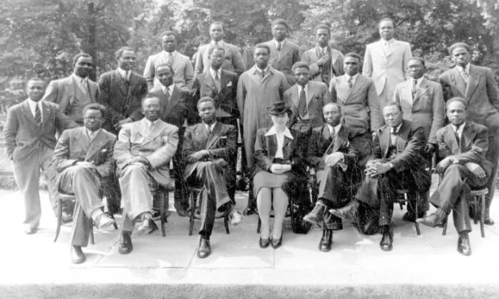
Notes:
https://www.historyworkshop.org.uk/black-history/the-fifth-pan-african-congress-75-years-on-a-landmark-moment-in-british-radical-history/#:~:text=The%20Congress's%20'Challenge%20to%20the,industry%20for%20private%20profit%20alone.

Slide 4
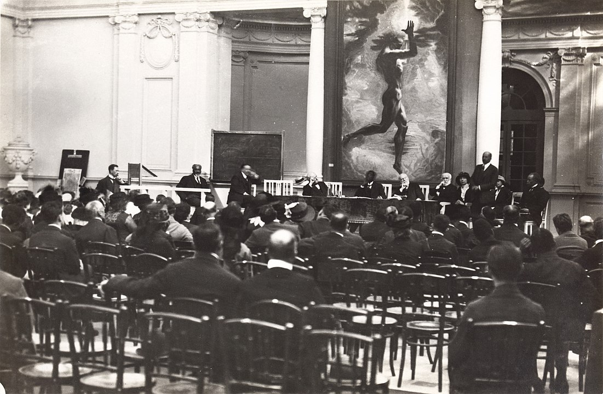
Notes:
https://www.racearchive.org.uk/the-1945-pan-african-congress-manchester-and-the-fight-for-equality/

Slide 5
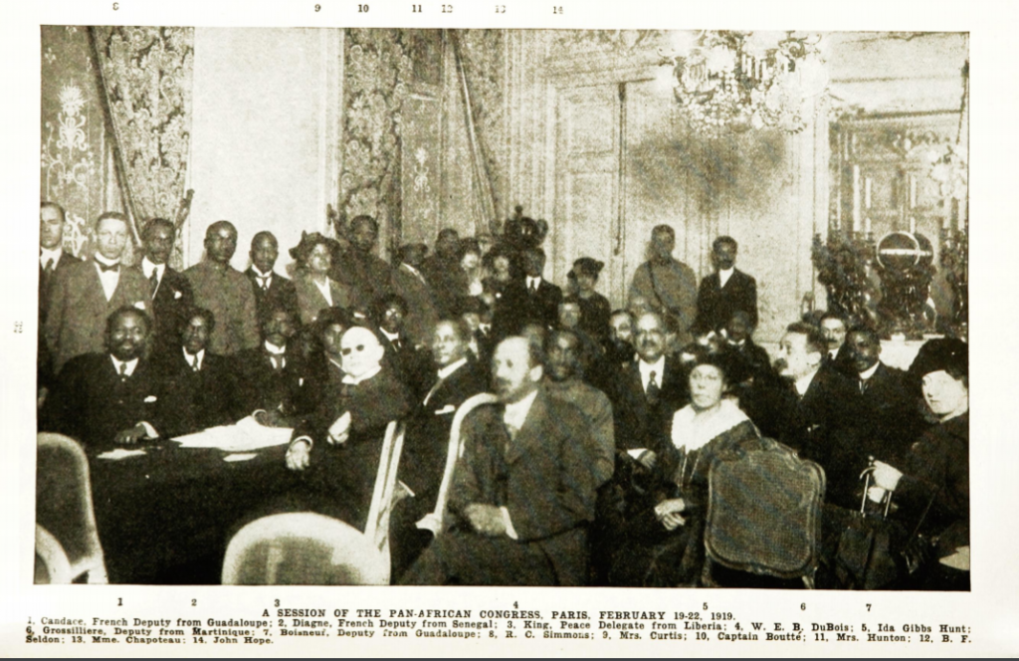
Notes:
https://www.racearchive.org.uk/the-1945-pan-african-congress-manchester-and-the-fight-for-equality/

Slide 6
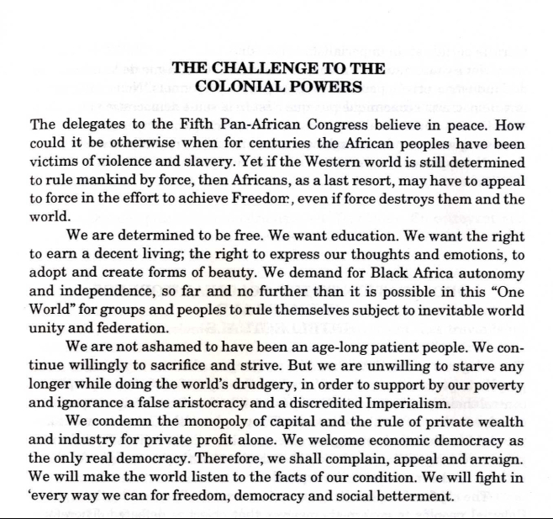

Notes:
https://www.racearchive.org.uk/black-history-month-2020/challenge-to-the-colonial-powers-e1551794370846/

Slide 7
Strong Communities Make Strong Movements

Slide 8
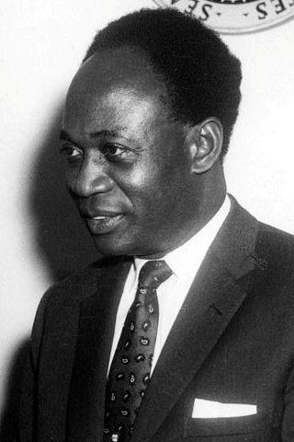
Figures of Interest
Amy Ashwood Garvey
Ras Makonnen
Peter Milliard
Peter Abrahams
Kwame Nkrumah
Alfred Gaisie
W.E.B. Du Bois
Jomo Kenyatta
Len Johnson
Kwame Nkrumah

Slide 9
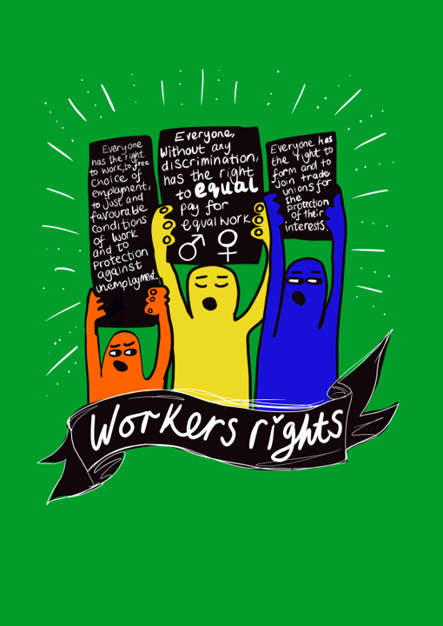
SESSION C:
Article 23
Article 24
Artwork by Emma Evans

Slide 10
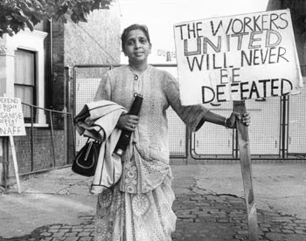
Jayaben Desai
“A person like me, I am never scared of anybody.”
On a hot day in London in 1976 she led a walk-out at the Grunwick film processing plant.
Many of the women who worked at the plant were mainly new immigrant workers.
They accepted long hours and low wages although Jayaben Desai said it, “nagged away like a sore on their necks.”
100 of her fellow workers joined on strike even though they weren’t in a union
Notes:
https://www.theguardian.com/politics/2010/dec/28/jayaben-desai-obituary

Slide 11
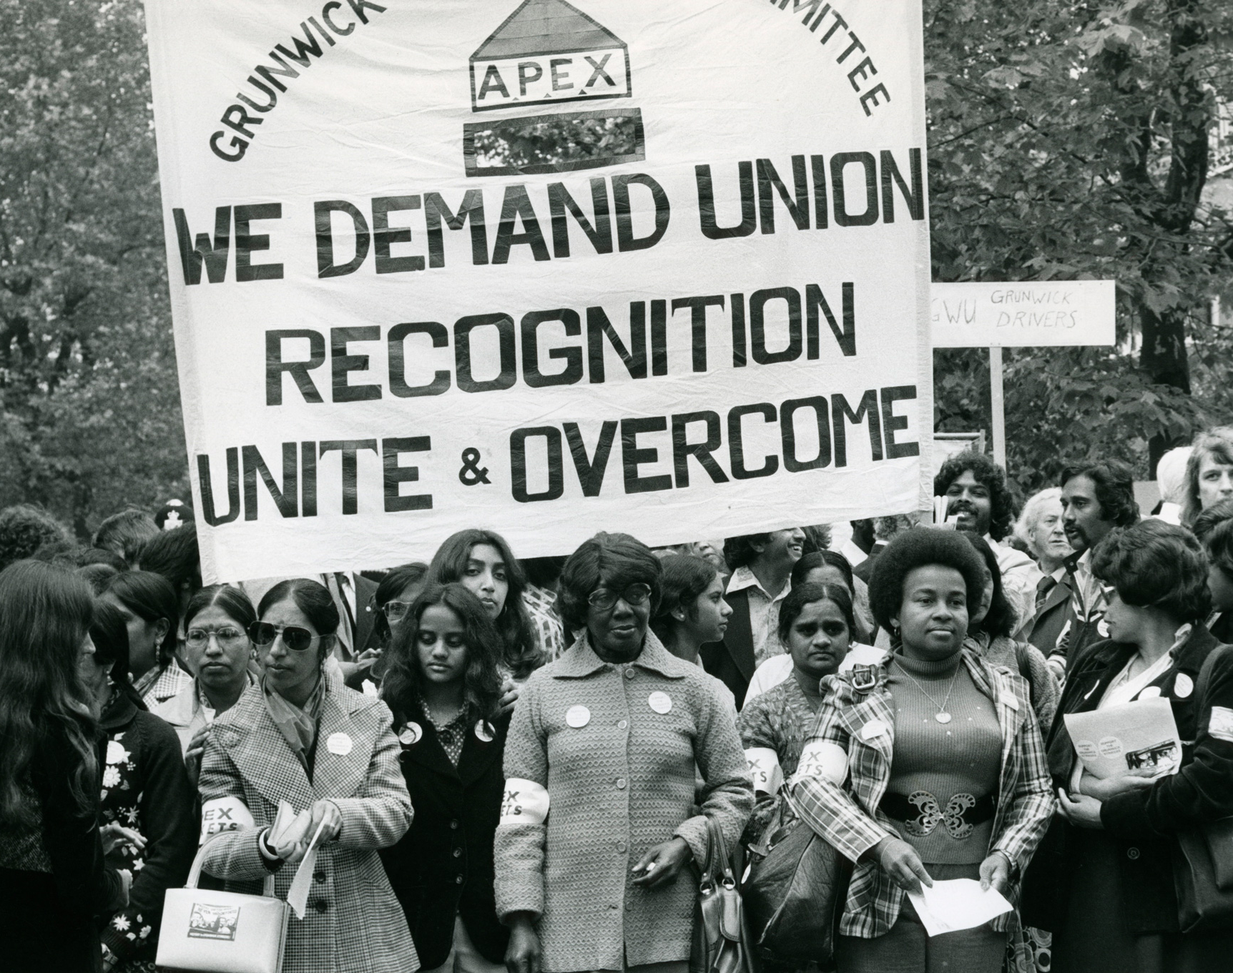
The Grunwick Strike
Jayaben Desai told her manager when she walked out, “What you are running is not a factory, it is a zoo. But in a zoo there are many types of animals. Some are monkeys who dance on your fingertips. Others are lions who can bite your head off. We are these lions, Mr Manager.”
The strike went on for two years and on one day in July 1977 they were joined by 20,000 workers.
Despite the strike being defeated in 1978, Jayaben Desai said “We have shown that workers like us, new to these shores, will never accept being treated without dignity and respect.”
Notes:
https://www.theguardian.com/politics/2010/dec/28/jayaben-desai-obituary

Slide 12

SESSION D:
Article 20; Everyone has the right to freedom of peaceful assembly and organisation
Artwork by Emma Evans

Slide 13
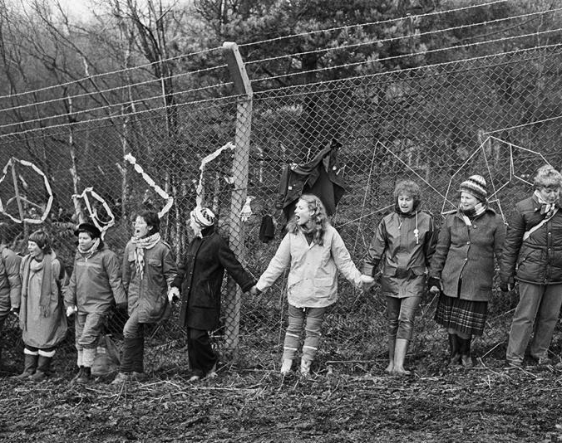
Greenham Common, 1981 - 2000
In 1981 a group of women, angered by the decision to site cruise missiles (guided nuclear missiles) in the UK, organised a protest march from Cardiff, Wales to Greenham Common Air Base near Newbury in Berkshire. Here they set up what became known as the Greenham Common Women's Peace Camp.
Between 1981 and 1983 the protesters attempted to disrupt construction work at the base. Their methods included blockading the base and cutting down parts of the fence. In December 1982 more than 30,000 women gathered at Greenham to join hands around the base at the 'Embrace the Base' event.
Notes:
https://www.iwm.org.uk/history/the-women-who-took-on-the-british-governments-nuclear-programme

Slide 14
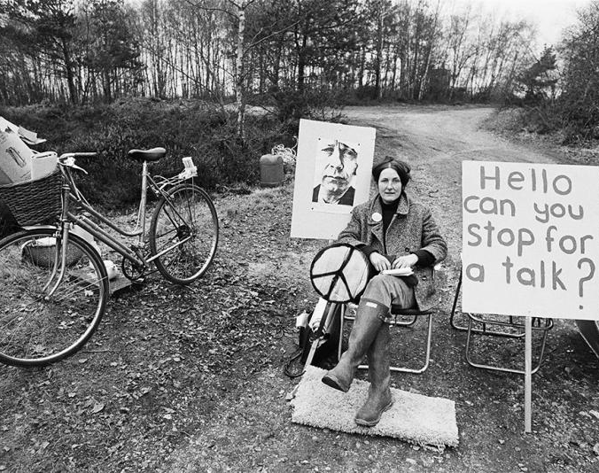
Greenham Common, 1981 - 2000
Despite the efforts of the protesters, in November 1983 the first cruise missiles arrived at Greenham. However, protests continued throughout the rest of the 1980s. Many women faced court cases, fines and sometimes imprisonment for their actions.
Newbury District Council tried many times to close the camp by evicting protesters but were unsuccessful. The numbers of women at the camp dwindled over time but it remained standing.
Notes:
https://www.iwm.org.uk/history/the-women-who-took-on-the-british-governments-nuclear-programme

Slide 15
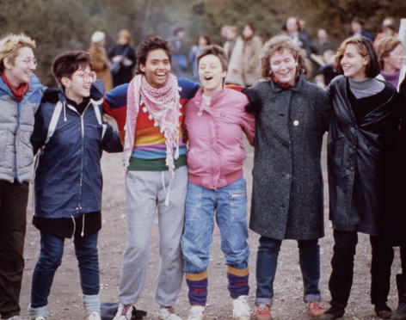
Greenham Common, 1981 - 2000
In 1987 US President Ronald Reagan and Soviet President Mikhail Gorbachev signed the Intermediate-range Nuclear Forces (INF) Treaty, which paved the way for the removal of cruise missiles from Greenham. Between 1989 and 1991 all the missiles sited at Greenham were removed. The United States Air Force left the base in 1992 and were soon followed by their British counterparts.
The Peace Camp remained as a continuing protest against nuclear weapons and the last of the Greenham women left the base in September 2000, 19 years after they'd first arrived.
Notes:
https://www.theguardian.com/uk-news/2021/aug/22/a-demonstration-of-female-energy-greenham-common-memories

